Slide 1
COGNITIVE PSYCHOLOGY
PSYC 4100
MW: 12:30– 1:45 CLASSROOM SOUTH 106
Matthew Babb
OFFICE: URBAN LIFE 1209

Slide 2
Attendance

Slide 3
Housekeeping
Notes:
This is a chance to learn more about how to best improve your learning in my class, and in other classes. I will also receive similar feedback on how to best improve my teaching to maximize your learning. Will not take the full class period, we will also dive into chapter 12

Slide 4
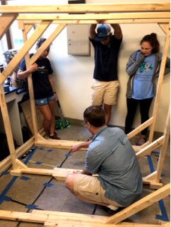
Introductions
Matt Babb
University of North Carolina at Chapel Hill
Biology B.S.
Geomagnetic Sensing in Sea Turtle Hatchlings
Notes:
What’s up everyone! My name is Matt Babb and I am a PhD Student here at Georgia State University.
Work in the same lab with Olivia
Unfortuantely JK JK shes 10x the scientist I will ever be
Before I came to GSU I was at UNC Chapel Hill where I worked with loggerhead sea turtles.
Remarkable ability to sense the earth’s magnetic field,
its how they are able to navigate around the open ocean and return to the beach where they were born to lay their own eggs.
My work involved building these large wooden structures, wrapping them with copper wire to create a mini MRI machine that I could then alter the magnetic field within the structure. I would use these magnetic coils to conduct experiments with sea turtle hatchlings.

Slide 5
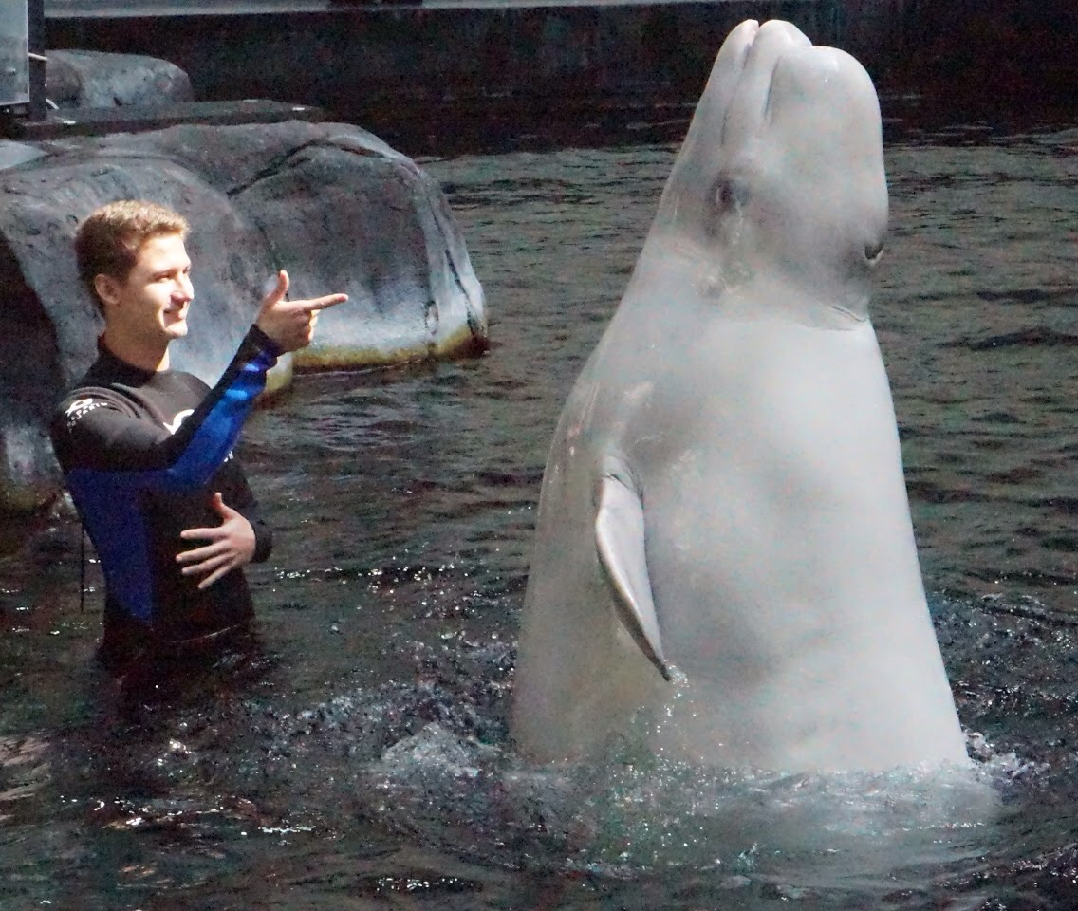
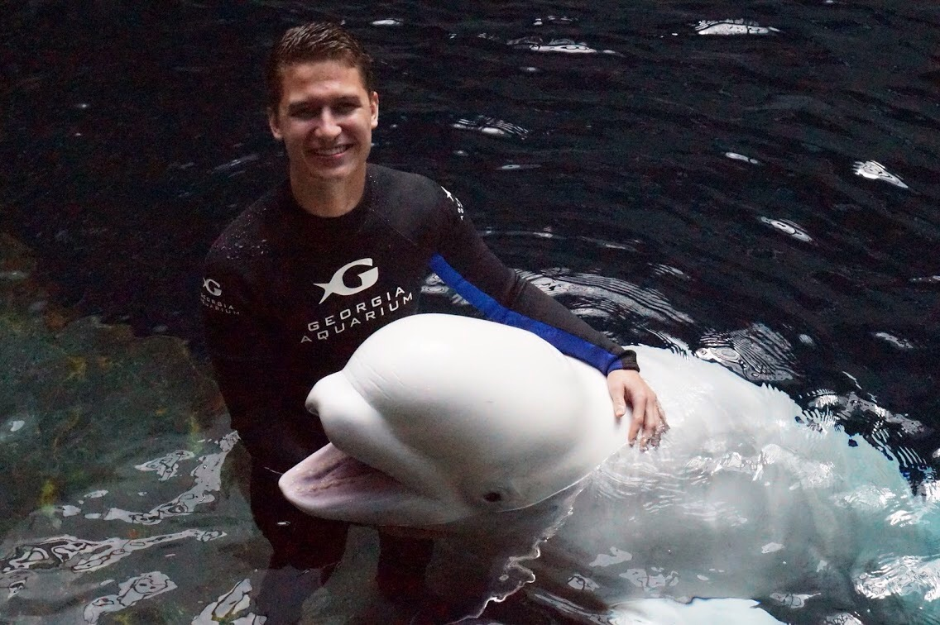
Introductions
Georgia Aquarium
Beluga and Seal Trainer
Notes:
After UNC, I spent some time at the Georgia Aquarium working with the beluga whales and the harbor seals. Who all has been to the aquarium?
Sweet! I worked to train both species and will even be running a comparative cognition study with the belugas next year.

Slide 6
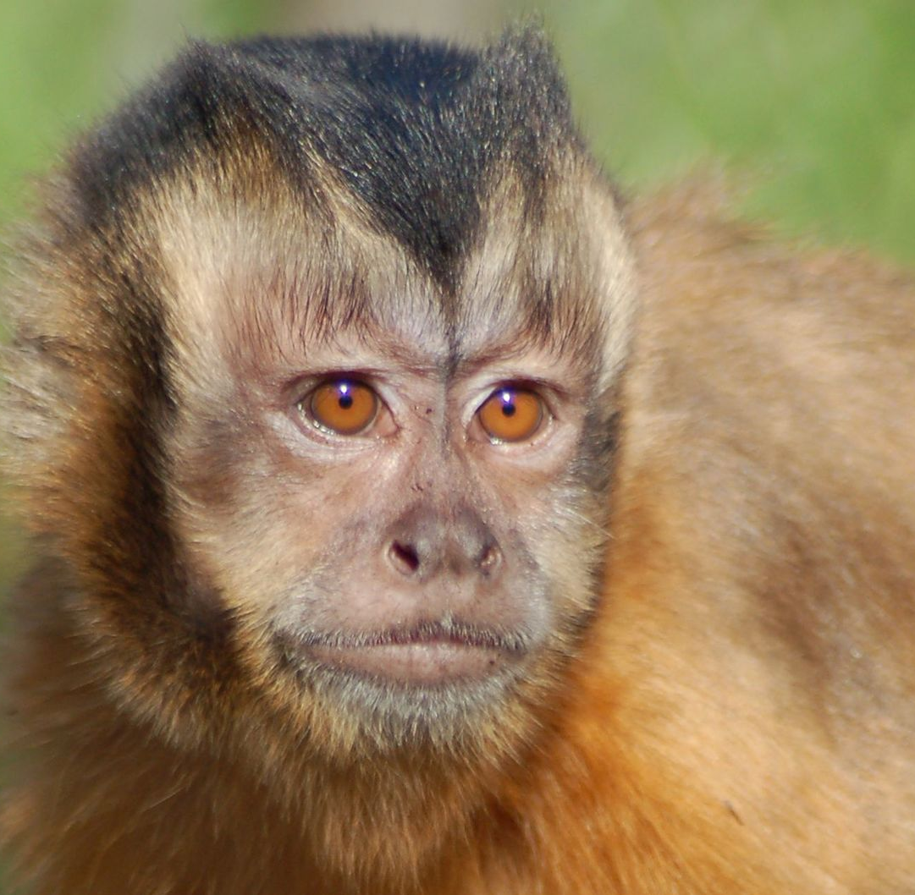
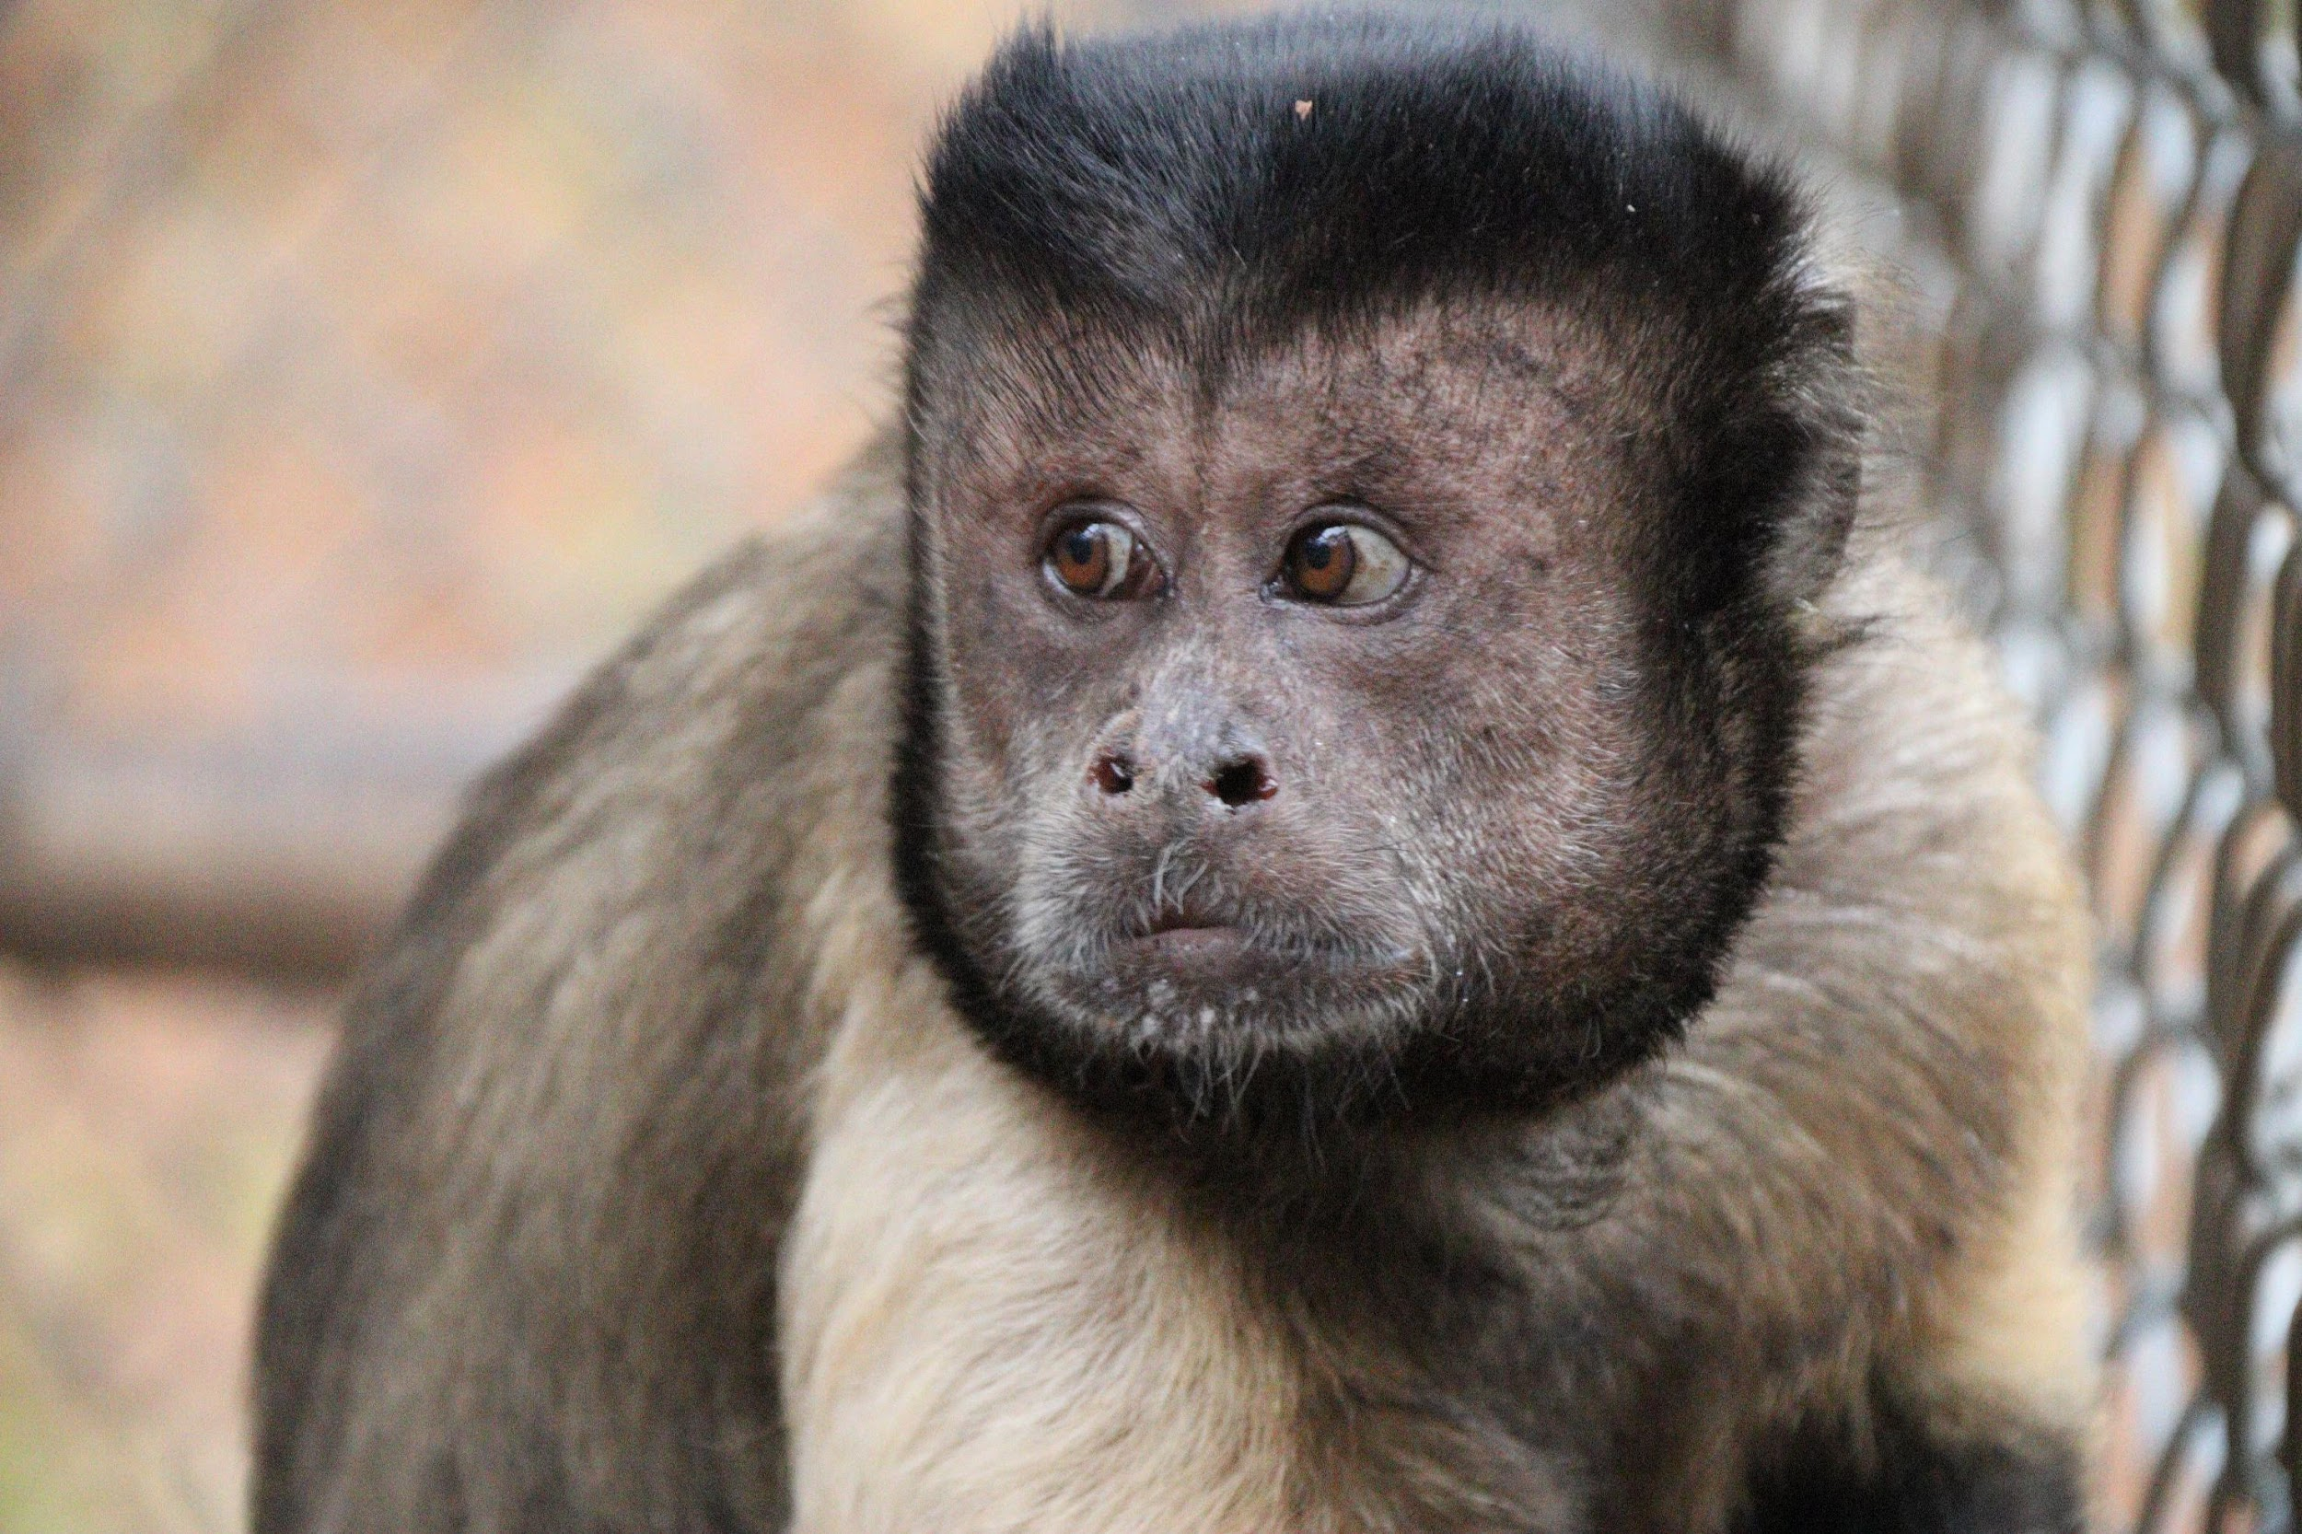
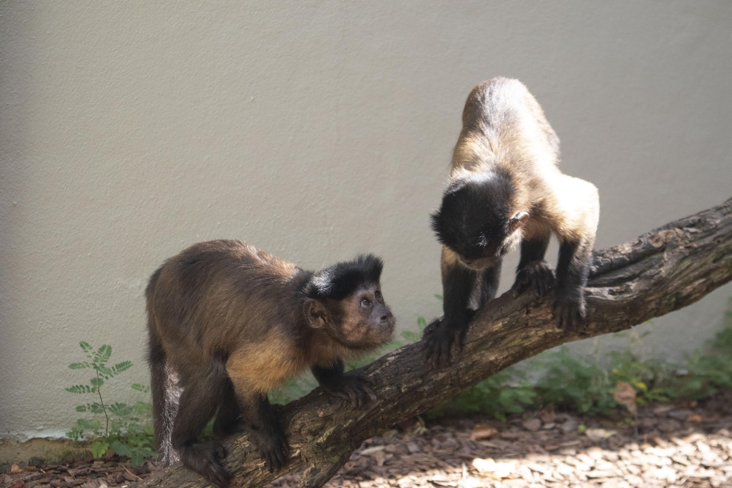
Introductions
Georgia State University
Psychology Ph.D.
Capuchin Monkey Social Cognition
Notes:
And like I said earlier, I am a second year PhD student at GSU.
I work with Dr. Sarah Brosnan to study capuchin monkey social cognition.
I am sure Olivia has shown you capuchin monkeys before but here are 4 of our monkeys that we have at Georgia State
shoutout Griffin in the bottom left he's my favorite
And since today’s lecture is on comparative cognition, I will tell you a little more about my specific projects later on today.

Slide 7
Comparative cognition
Notes:
SIERRA
As both Matt and I are currently in a comparative cognition lab, today we will be telling you about comparative cognition.

Slide 8
Comparative Cognition
The comparative study of the mechanisms and origins of cognition in various species
Goals
1. What are animals capable of?
2. How cognition evolved?
Notes:
SIERRA
So what is comparative cognition? Comparative cognition is studying the cognitive processes in other distantly related species. So basically its studying all the things that you guys have looked at throughout the entire semester, like perception, memory, or illusions, but in other animals. This research usually has two main goals.
First, its just interesting to learn what animals can do and what they are capable of and by learning what animals are capable of we can the look at the second point.
which is, most comparative cognition tries to understand how these certain cognitive processes evolved in our own evolutionary history and by doing this we can then understand cognition on many different levels. And when we say levels, we as scientist use Timbergens four questions as a guide.

Slide 9
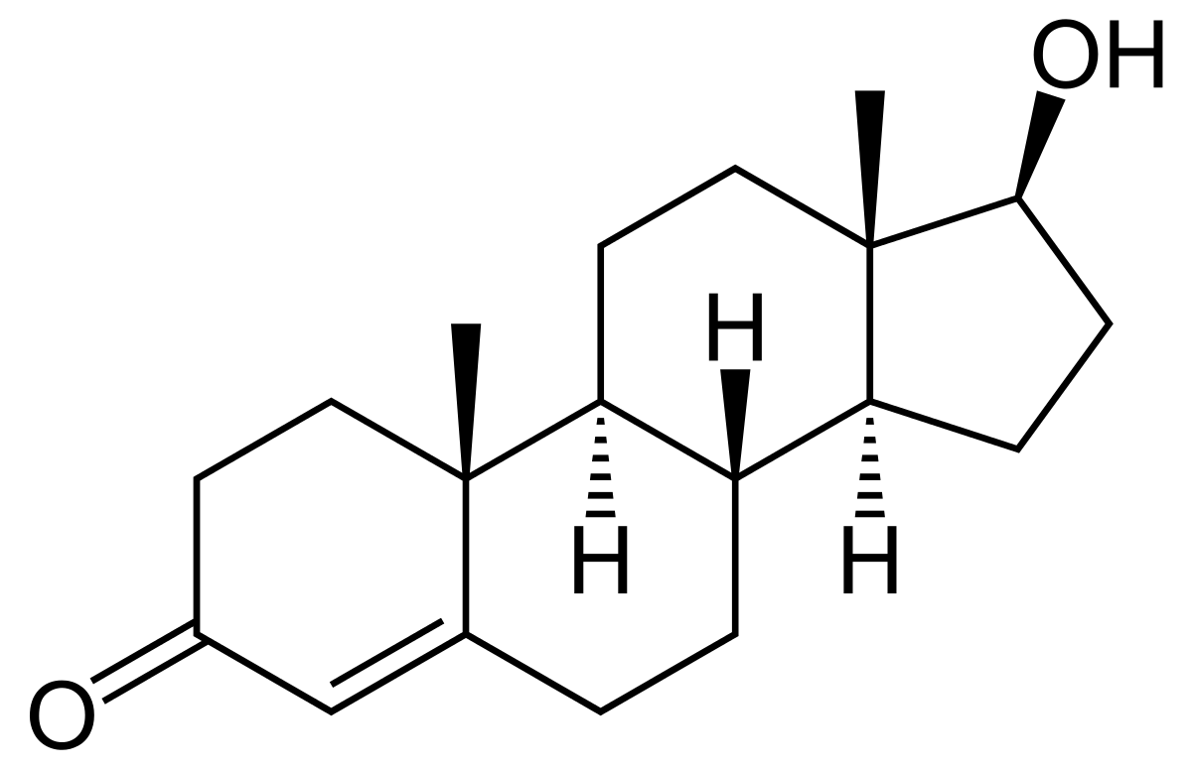
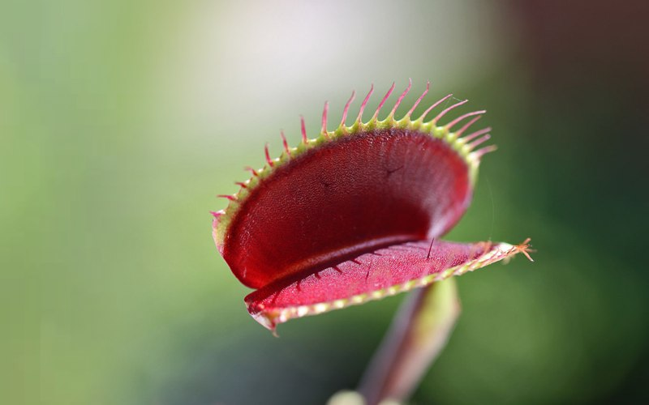
Comparative Cognition
Tinbergen’s four questions (1963):
Mechanism (causation)
Notes:
MATT
When studying comparative cognition, we as scientists, usually focus on these four questions.
All four of these questions are important in having a full understanding of behavior and cognition.
Originally proposed by Nikolaas Tinbergen in 1963
Tinbergen is commonly known as one of the founders of modern ethology, which is the study of animal behavior.
Although Tinbergen published on these questions a long time ago, these same questions are fundamental to the way we comparative psychologists conduct research. We can often see how all these questions interact and build off each other too.
The first question asks about the mechanism of a behavior. So for example: we might ask,
“What causes the behavior to be performed?” or maybe “What stimuli causes the subject to do what they are doing?”
I really want to put an emphasis on the word “causes” because usually if your question involves that word, it is probably a mechanism question.
Some common examples of mechanistic research might be like hormones or external stimuli. For example, maybe I want to ask
“Does increased Testosterone cause increased aggression?”
Or “Does physical touch cause a venus fly trap to close its snaptrap?”

Slide 10
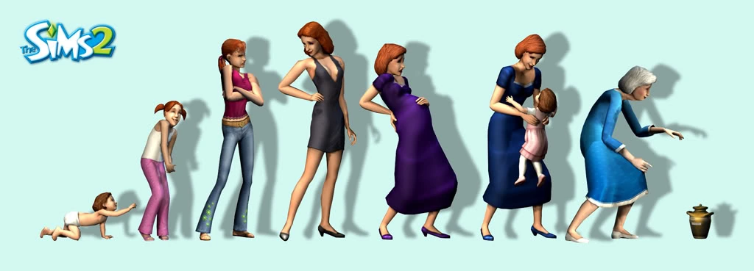
Comparative Cognition
Tinbergen’s four questions (1963):
Mechanism (causation)
2. Ontogeny (development)
Notes:
The second question asks about the development of a behavior. Another word for this is Ontogeny.
This examines how a behavior or cognitive process develops during a lifetime. And Many questions focus on to what degree can a cognitive process or behavior change through learning.
Some of you may have taken developmental psychology. That field focuses a lot on this question.
Some examples of questions you could ask may be “How does play behavior develop throughout childhood?” or “How does courtship behavior develop in birds?”
These questions are important, and you can ask comparative cognition questions about development. There are many comp psychologists that will ask developmental questions in other species, and will often try to relate these questions to human development. A common one for example is play behavior.

Slide 11
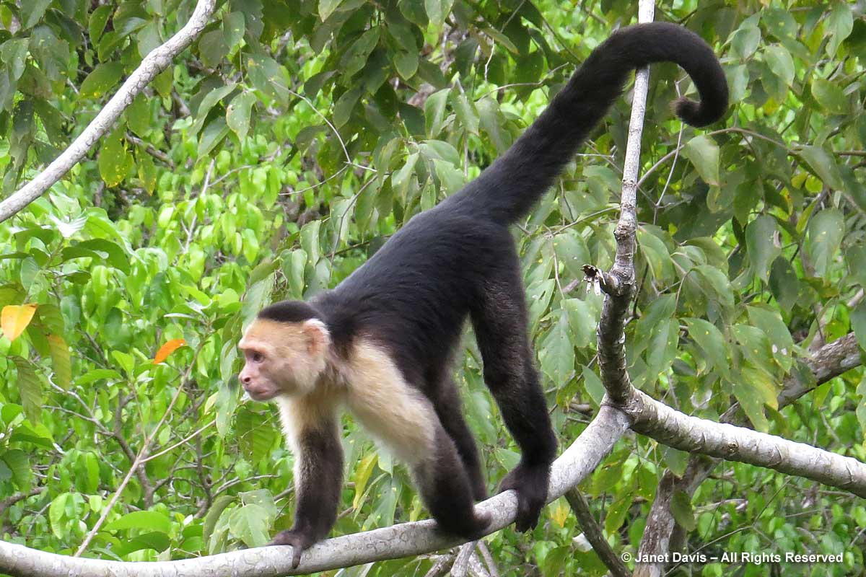
Comparative Cognition
Tinbergen’s four questions (1963):
Mechanism (causation)
2. Ontogeny (development)
3. Adaptive value (function)
Notes:
Next we have the questions about adaptive value.
Ask: from an evolutionary perspective, why are these traits or behaviors the way they are? What sort of advantage do they provide an organism?
EX: why do humans nurse their young? Maybe such a behavior increases the survivorship of an offspring? If that behavior has adaptive value, we would expect it to provide some sort of advantage to the organism via increasing survival or itself or its offspring or increase its ability to reproduce
Or maybe I am interested in why capuchin monkeys have long tails.
Swing from trees?
Escape Predators?
Catch Prey?

Slide 12
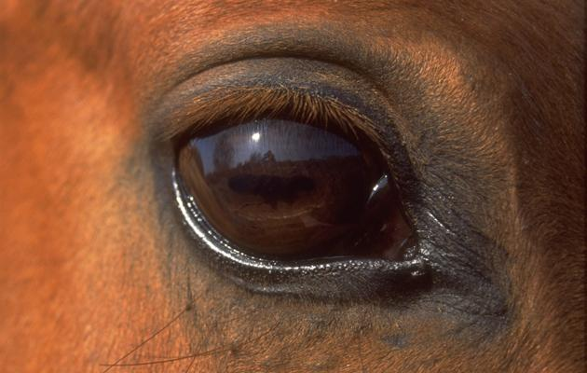
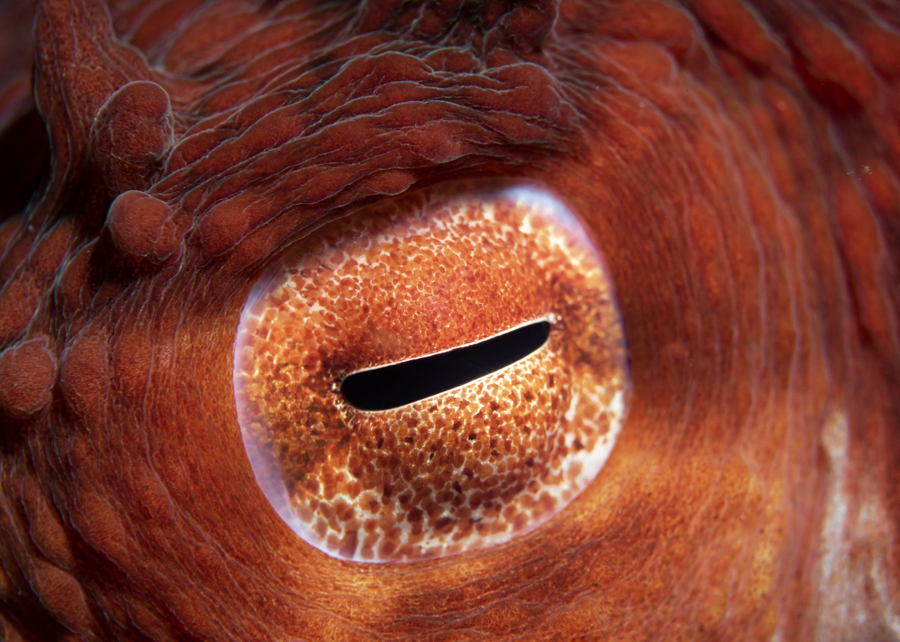
Comparative Cognition
Tinbergen’s four questions (1963):
Mechanism (causation)
2. Ontogeny (development)
3. Adaptive value (function)
4. Phylogeny (evolution)
Notes:
And lastly we have evolution, or phylogeny questions.
Ask: how did this behavior or cognitive ability evolve? and when in the evolution of a species did such a phenomenon evolve?
EX: maybe I want to know how bird flight evolved from gliding dinosaurs
EX: how both vertebrates and cephalopod – which are like squids – evolved to have a similar eyeball structures despite evolving a long long time ago from an organism without that eye structure?

Slide 13
Comparative Cognition
Tinbergen’s four questions (1963):
Mechanism (causation)
2. Ontogeny (development)
3. Adaptive value (function)
4. Phylogeny (evolution)
Proximate: explanation in terms of immediate factors
Notes:
All 4 of these questions fall under one of two categories.
The first two = known as proximate questions

Slide 14
Proximate Questions
Mechanism and Ontongeny
Explain phenomenon in terms of immediate factors
Immediate mechanism for why a behavior is expressed
Examine organisms at the individual level
Notes:
Focus on explaining a phenomenon in terms of immediate factors.
Look at the immediate mechanism for why a behavior is expressed
hormones for mechanism questions or learning for ontogeny questions are both great examples to think of for these questions
Another important distinction is that these questions focus on the organism at an individual level

Slide 15
Comparative Cognition
Tinbergen’s four questions (1963):
Mechanism (causation)
2. Ontogeny (development)
3. Adaptive value (function)
4. Phylogeny (evolution)
Proximate: explanation in terms of immediate factors
Ultimate: explanation in terms of the processes and forces of evolution
Notes:
Second two Qs = Ultimate or Evolutionary Questions

Slide 16
Ultimate Questions
Adaptive Value and Phylogeny
Explain how a phenomenon came to be in terms of evolutionary fitness
Longer perspective in terms of time
When and why a cognitive process evolved in an organism and related species
Organisms at the population level
Notes:
Focus on explaining how a phenomenon came about in terms of evolutionary fitness
Take a much longer perspective in terms of time
Explain why the cognitive processes or behaviors evolved in a species and related species, and also examines when the behavior evolved in an organism's evolutionary history
The proximate questions focus on the individual level, but ...
These ultimate questions focus on the organisms at the population level
Comparative Psychologists: usually attempt to understand how cognitive processes compare amongst closely related species,
In doing so we find
how they evolved,
what adaptive value a trait or behavior has,
and what environmental pressures may lead certain cognitive processes to evolve

Slide 17
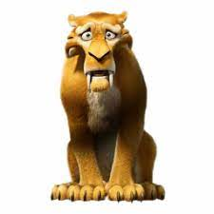
Lion
Leopard
Tiger
Domestic Cat
Ancestor
Current Species
Notes:
PHYLOGENETIC TREES
Comparative psychologists utilize these A LOT. Show of hands, who knows what phylogenetic trees are?
Alright so for those of you who haven’t seen these yet or maybe need a refresher, I am going to give a quick intro about them.
This is an example of a phylogenetic tree of some of the cat species. Its kinda like a family tree but over millions of years and its based on the evolution of species.
Start on the right side, these are all the species that are alive today. Lions, Leopards, Tigers, and Domestic cats
As you move from right to left you are essentially going BACKWARD in evolutionary time.
Orange dot: common ancestor of lions and leopards but NOT tigers
Blue dot: common ancestor of tigers, lions, and leopards
Red dot: Common ancestor of all these species that existed so many millions or billions of years ago
SOME TREES → Pink dot: a species that was closely related to tigers, but went extinct a long time ago. [CLICK]
EX: Diego the saber tooth tiger from Ice Age
-Lions are most closely related to leopards
-Tigers are closely related to leopards and lions and that amount of relatedness is equal
-Domestic cats = related to all of them, but much more distantly related

Slide 18
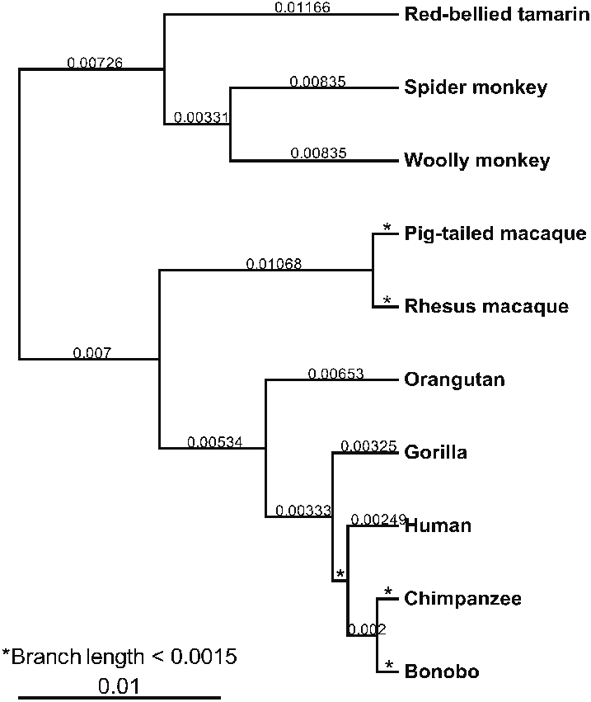
Ancestor
Current Species
Notes:
MATT
It might be easier to look at this in terms of primates because we have a better understanding of animal relatedness
By looking at this tree we see that humans are most closely related to chimpanzees and bonobos (which are like smaller chimpanzees) [CLICK]
We know this because the branch point or the common ancestor occurred not that long ago
Compared to say gorillas [CLICK] our common ancestor with them is a little further to the left
Therefore, we are more related to chimps than we are to gorillas

Slide 19
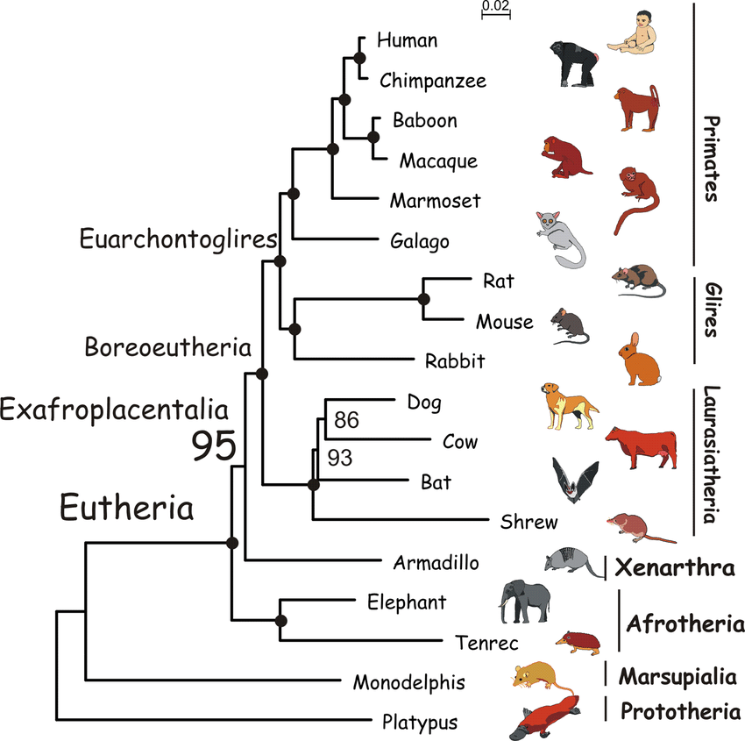
Notes:
Okay cool so that’s what we do. As comparative psychologists we take animal models and we ask questions about all the same cognitive abilities that you guys have studied this semester.
Whether that’s D-M, learning, or attention, we can use animals and ask very similar questions.
Both because we want to know what an animal is capable of and also because it might help us answer the ultimate question of “when, how, and why did such a cognitive ability evolve?”
Okay this is going to be a ridiculous example, but its to show you guys how we as comparative psychologists might do this kind of work.
Netflix indecisiveness: anyone else? [REACT] Let’s say we want to find out when this Netflix indecisiveness evolved.
Well we know that it’s something that happens in humans so CHECK! Now let’s test it in chimpanzees. Give them Netflix and …
…boom just like that chimpanzees also take a long time to decide between tiger king season 2 and ozark. We can also do the same thing in let’s say marmosets. Turns out they also are bad at deciding. Boom.
But then when we test it in galagos –which are also known as bush babies – they pick a Netflix show almost immediately.

Slide 20
1
2
3
4
Notes:
So if you were a comparative psychologist, and you wanted to best predict where this Netflix indecisiveness evolved, or…
each dot represents an ancestral species, which of these species most likely had this netflix indecisiveness?
, which would be your best guess? Hold up your finger 1, 2, 3, or 4.
Cool yes 3 is correct! Because it makes the most sense that it would have evolved right before the branch or marmosets and the other 4 species. But since bush babies are much better at choosing a Netflix show than us, it likely evolved after them.

Slide 21
Notes:
As you can imagine though, it’s a lot more complex than that. For example, sometimes we don’t have all the information on all the species

Slide 22
Notes:
Or sometimes we have results that show a cognitive ability in some animals but not all the animals indicating the ability evolved more than once in our evolutionary history.
I am not going to get too much into all these different possibilities, but it is our job as comparative psychologists to ask and answer these kinds of questions. Specifically with regards to cognitive abilities.

Slide 23
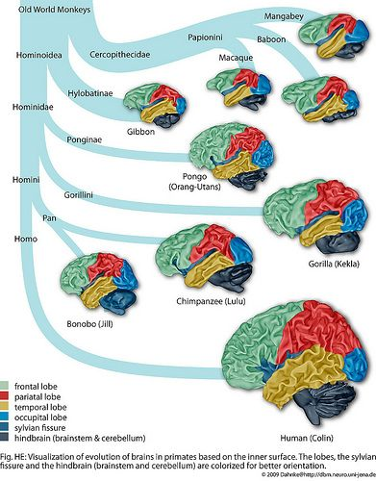
Notes:
SIERRA
Matt gave us an in depth example of how we apply phylogeny within behavioral research. But prior to using this approach when looking at behavior, relatedness was assessed using physical characteristics. In fact, it was the physical similarities and differences that prompted Darwin to come up with the theory of evolution and he had come up with a simplified version of the “tree of life” based on his notes on these similar and different physical characteristics. And as you can probably extrapolate, the same is true from brain structure. Here on this slide you can see that all these different species of primates have the same brain regions, but vary on the size and shape. You can also see here that they vary in the amount of grooves. as you can see the mangaby’s brain is smoother than the human who have many gyri and sulci.
Brain structure similarities and differences are very important for the study of cognition, as we can imagine cognition is limited by the physical hardware in which we gain cognition from. What I mean by this is… explain. Then this is even more helpful because as we study the behavioral side of cognition we can then look at the physical mechanism within the brain of those species that share that behavioral cognitive phenotype. Hopefully helping us pinpoint how the physical brain can output these cognitive functions that we see.

Slide 24
Notes:
We have established what comparative psychology is, what questions we can ask, and why we do it.
Now I want to ask you guys a question. We know we use animals as models for understanding the cognition of both humans and other species, but what kinds of animals do you think would be good models and why?
There are no wrong answers but think about it in terms of availability as well as evolutionary closeness
[Ask for a couple answers]

Slide 25
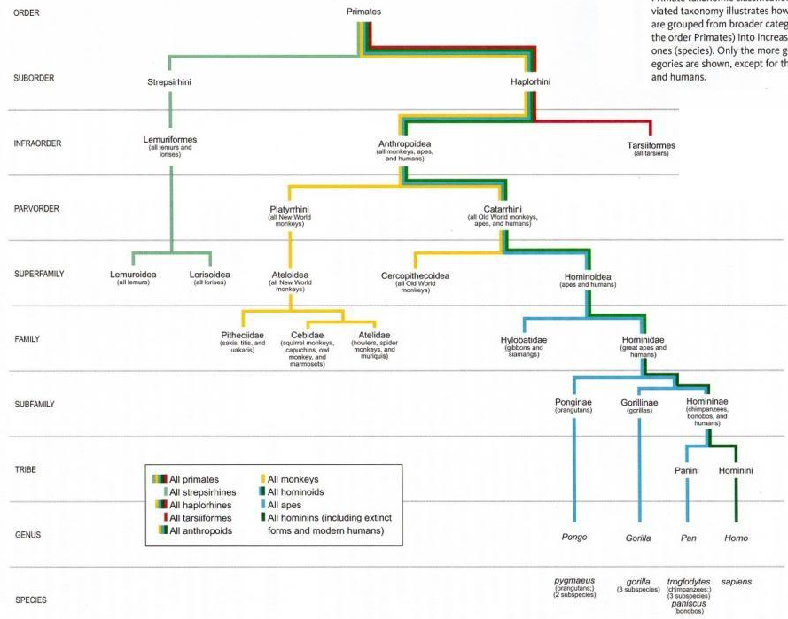
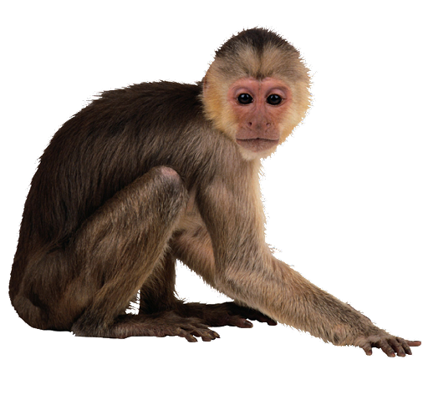
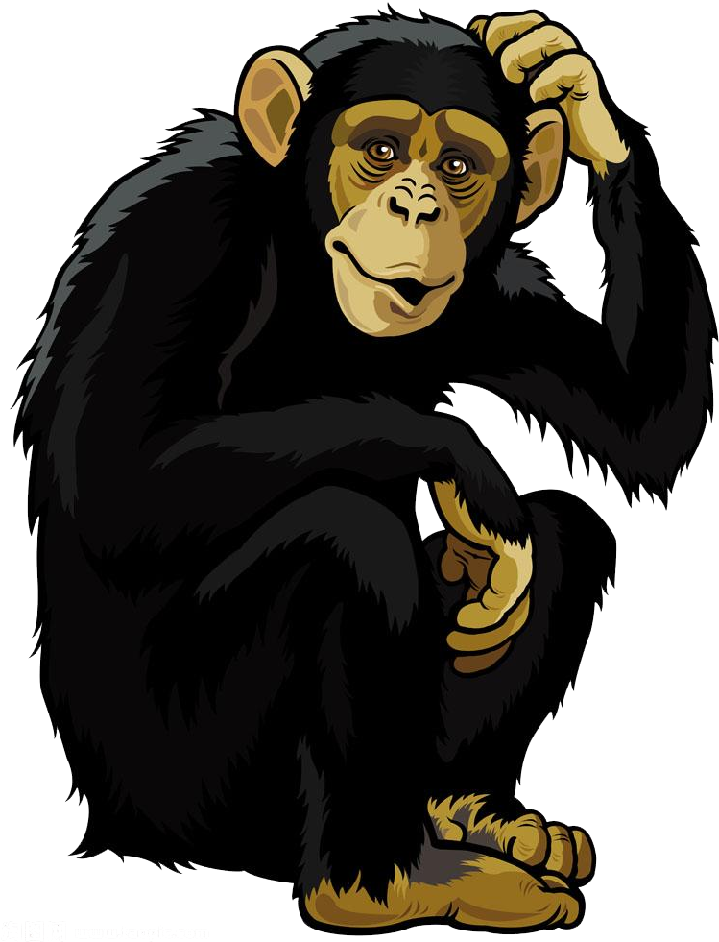
Notes:
All great answers!
Primates are great because they are really close to humans so its easy to explore a lot of the cognitive functions that we have in them
Humans are here
Chimps are here
And capuchins, which is the species that all of us work with are right here

Slide 26
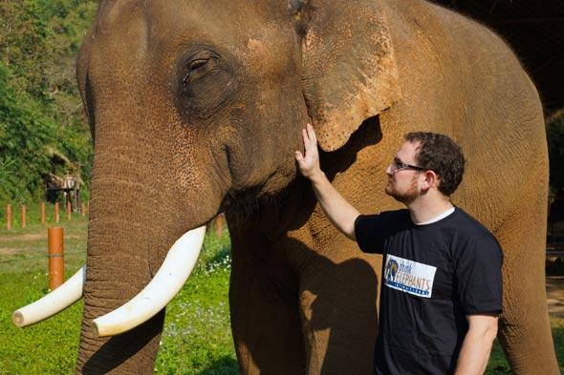
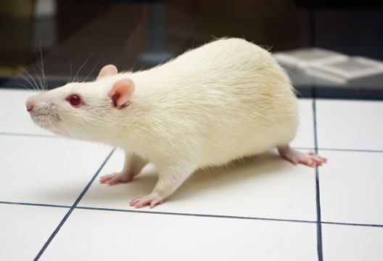
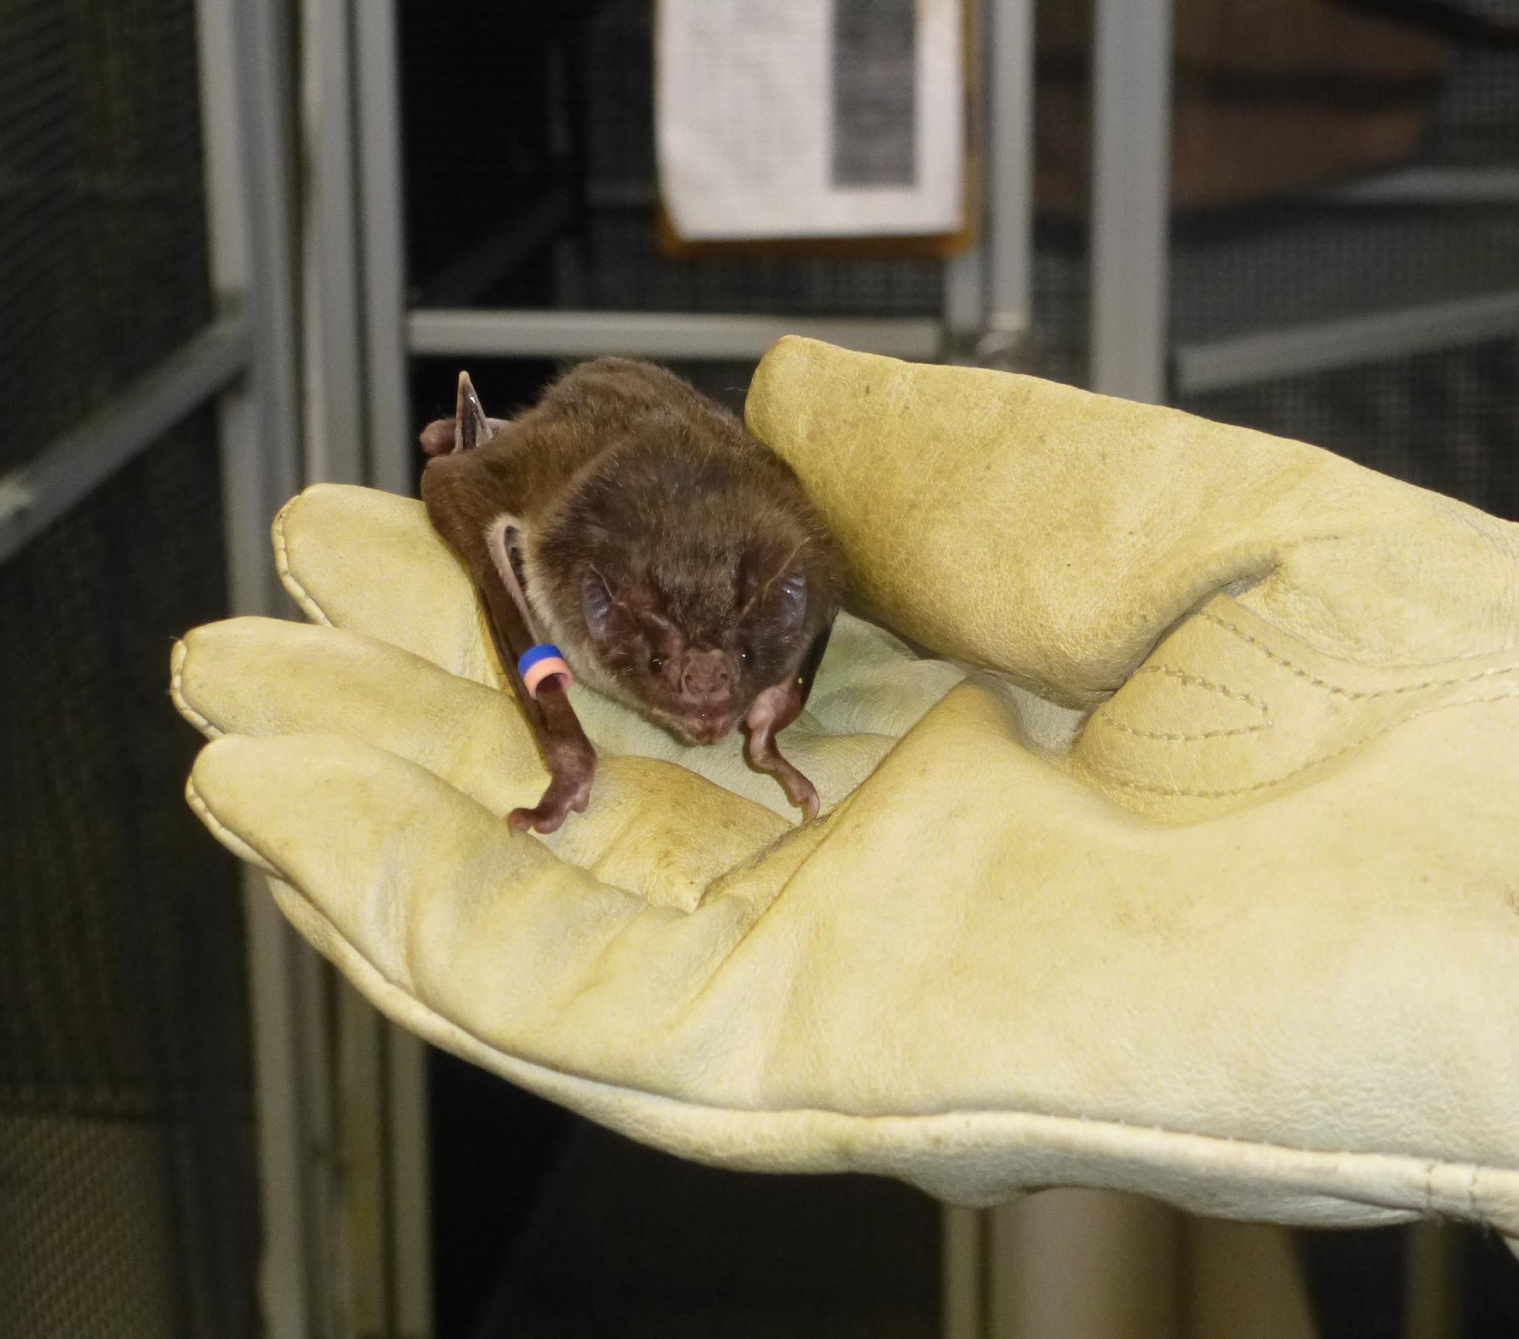
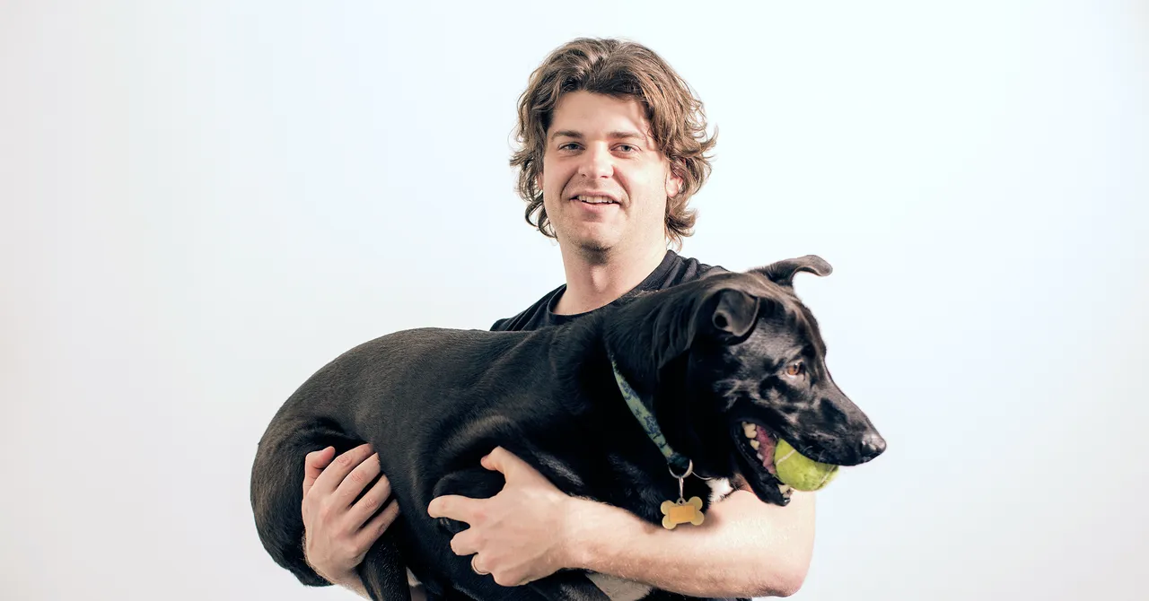
Notes:
But primates are not the only animal we can study.
Comparative cognition can be done in pretty much any species, it just depends the question you are trying to answer and what the advantages of each species is.
Transition to current research on the very cognitive processes you guys have learned about, but any Qs?

Slide 27
Self Control
Human children
https://youtu.be/Yo4WF3cSd9Q
Notes:
Okay so the first cognitive ability we will look at is Self-Control.
If you guys aren’t familiar with the marshmallow task, we are going to watch a quick video of it. But essentially it’s a way that we can measure the cognitive ability of self-control in children. Take a look
Love that study cute video, but the cool thing is… we can also test this in animals

Slide 28
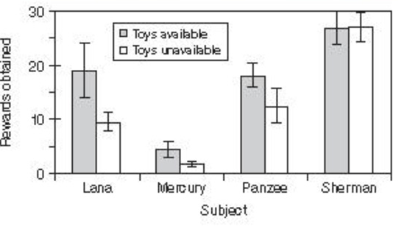
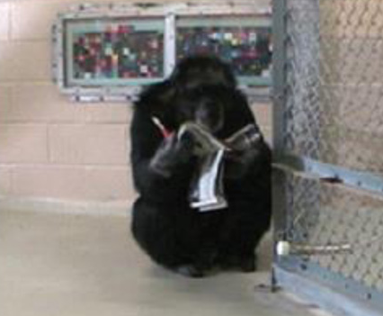
Self Control
Self-control – chimpanzees
Notes:
These are the results from a similar study in the chimpanzees we used to have at GSU.
This was called an accumulation task, but its very similar to the marshmallow task.
- chimps sit and wait and an experimenter would place a food reward in front of them every so often,
so lets say every minute they waited they got another raisin
X axis is the chimp, there were 4
Y axis is the number of rewards they obtained
Sherman = Self control
Mercury = Not so much
Lana = Toys helped increase her self control
They also tested another condition to see if having access to toys helped with their self control. So the grey bars = toys were available to play with the white bars the chimps had no toys.
Lana, the toys seemed to help

Slide 29
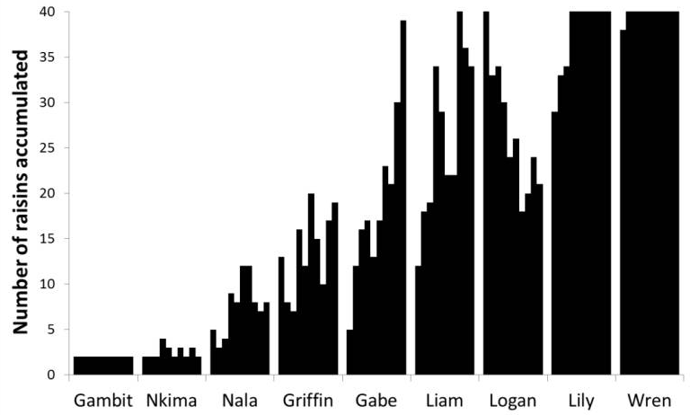
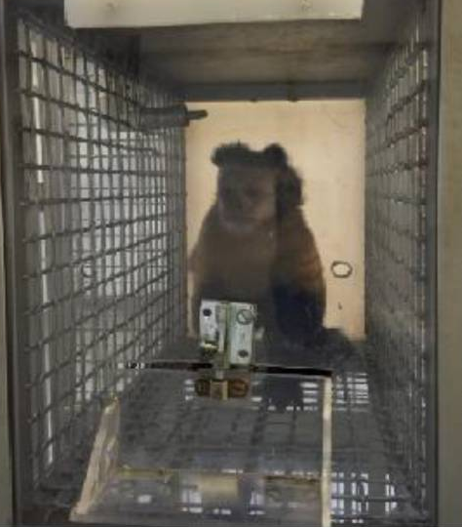
Self Control
Self-control – capuchins
Notes:
Here is a similar test done in our capuchins at Georgia State. This experiment did not look at the presence of toys and it used raisins as the reward
x axis = each individual monkey
y axis = the number of raisins each monkey accumulated in each of its trials
Gambit = no self control
Wren = A LOT of self control
So what’s the significance of these results? The main takeaway?

Slide 30
Self Control
Primates have the ability of self control
Some are better than others - “Individual Differences”
See similar results in humans
Some studies have linked a child’s ability to delay gratification to their achievement later in life
From these results we can ask follow-up questions
Was the test ecologically relevant?
Why might this species act show these results?
Do we see similar results with amount of self-control and intelligence?
Notes:
First: primates do have the ability to wait and delay their rewards for bigger ones. We know this because some individuals waited a long time for a lot of rewards to accumulate
There was a lot of individual differences though, with some doing way better than others
This mimics the results seen in children.
From these results we can ask follow up quesions
***delay gratification = achievement. is this true in monkeys?>

Slide 31
Chunking and Decision Making
Configural Learning – Similar to “Chunking”
Definition: “learning to respond to two or more stimuli on the basis of their combination rather than on the individual experience of that stimuli alone”
6 7 8 - 9 9 9 - 8 2 1 2
Triple 9
Notes:
Next we will look at a study that examined learning and D-M
Little bit of a shameless plug because this is my own study, but its also a testament to the difficulty often faced by comparative psychologists
Recently finished project that looked at how capuchins learn to make a foraging decision
Specifically looked at configural learning, which is similar to chunking where you chunk information together rather than encode each individual element, and some use the two terms interchangeably
Defined as: “learning to respond to two or more stimuli on the basis of their combination rather than on the individual experience of that stimuli alone”
This form of learning is useful in short cutting information and optimizing human decisions, so I was interested to see if it would help capuchins!
Want to remember Soulja boy’s phone number, remembering each individual number is difficult, but if I chunk them together
BAM! it becomes easier. Also shout out soulja boy for Kiss me thru the phone, that is a bop and a half

Slide 32
Chunking and Decision Making
Do capuchin monkeys chunk when foraging?
Notes:
I wanted to know if capuchins chunk while they forage
Imagine you’re a capuchin out foraging and you come across an insect and a fruit. Presumably you need to make a decision, do you go for the fruit or the insect first
Go over contingency
So you should go for the insect first
But as you can imagine, this isn’t the only configuration you would come across, so you need to be flexible.
I won’t get too much into the nitty gritty of this task, but I wanted to know if the capuchins learned to prioritize the insect via chunking if it would help them to always prioritize the insect no matter what configuration they experienced.

Slide 33
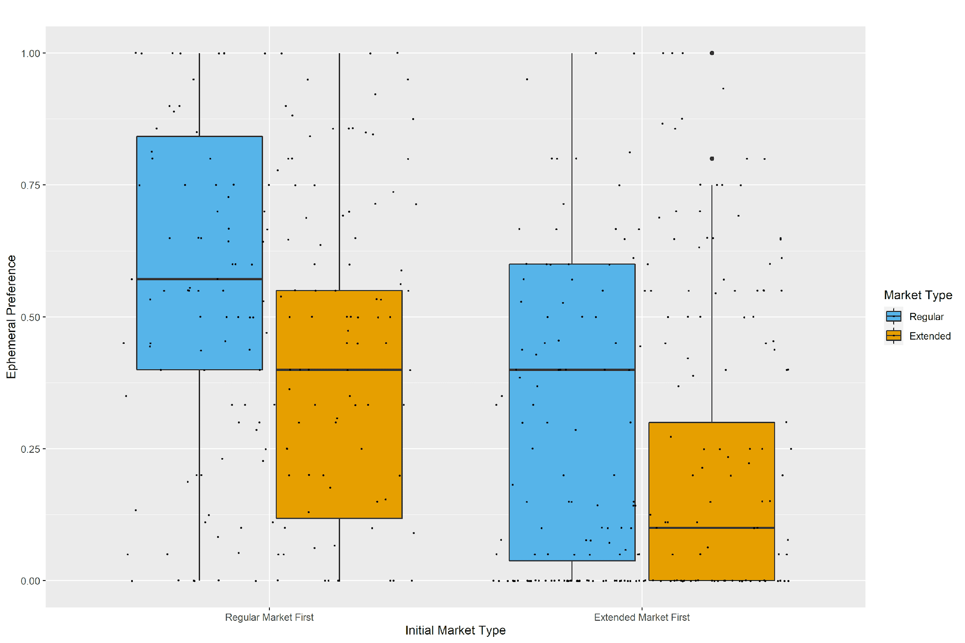
Chunking and Decision Making
Chunking
No Chunking
Notes:
Used our capuchins and I tested them on this very thing.
Half the monkeys were trained in a way that allowed them to use configural learning and the other half were trained in a way that made chunking difficult.
Then I tested to see who prioritized the ephemeral insect option. If they are using configural learning in this process, then I would expect to see a higher preference for ephemeral insect in group 1 who chunked than group 2 who did not.
Here are my results
Red line: 50% guess threshold
Although the monkeys who were trained with configural learning seemed to do better than those who did not train with configural learning, this difference was not significant.
We can conclude the monkeys are not using chunking in this process, but its alwayspossible that some are. But on a group level as a whole they are not.

Slide 34
Sociality
The social environment can have a wide range of implications
Humans live in a very complex social environment
Sociality and cognition?
Notes:
So the next topic we are going to discuss are topics involving sociality because this is a topic that both Matt and I are focused on in our own research.
Overall, the social environment can have a wide range of implications on the individual. These implications can be positive or negative. For example, high levels of social rejection is linked to suppressed immune function and a decline in overall health. But on the other hand, having a strong sense of community and social support has been correlated with a longer lifespan in humans.
And i mean if you look around in your daily life, sociality and social stimuli is a part of almost everything we do. From going to work or school with others building something bigger than yourself, to then going home and watching tv where the things we watch are focus on the lives of other people in form of characters. But from a research point of view, humans have a very complex social environment. For example, it is very difficult for me to study someone and gain a full understanding of a person's social environment. So, we often look to comparative work, and look at animals with less complexity surrounding their sociality.
But you all may be wondering how sociality may relate to cognition? Let’s just start by thinking of the social environment compared to the natural environment. If you are an animal looking for food, you may have seasonal changes of food distribution which can be in the time frame of months, but social interactions might change by the minute, a group member might decide to groom you. you have to be able to process who that individual is, if it is a good thing that they are grooming you, and how to interact with them in the proper way accounting for all the things you know about the individual grooming you. Some argue that it is one of the most dynamic environment you can interact with, and in order to deal with that you have to have really complex cognition. In fact there are academics that believe that engaging in a more complex social environment played a large role in the evolution of complex cognition like we see in humans today. Sociality as a whole is a very large field, so we are only going to dive into a couple of topics today.

Slide 35
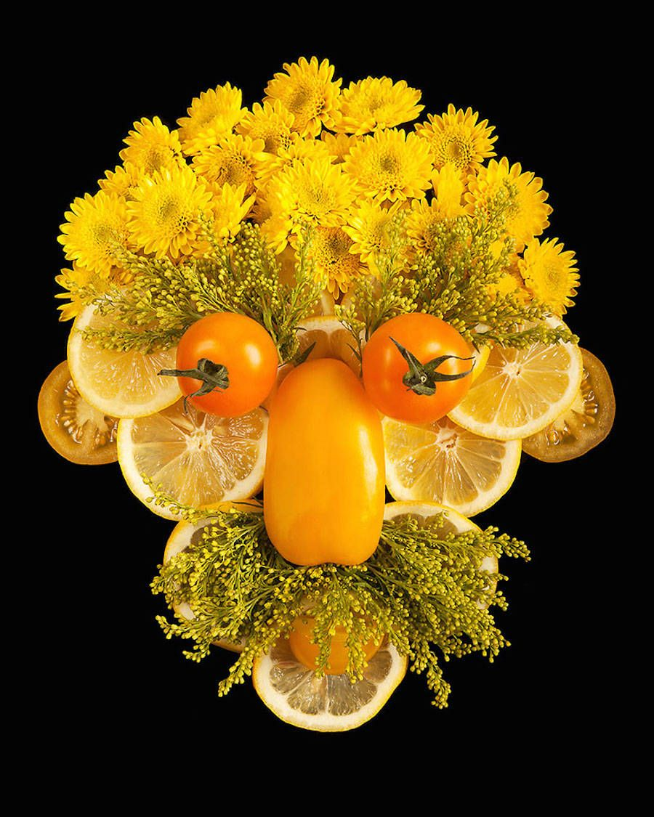
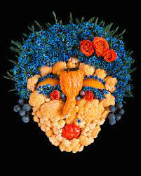
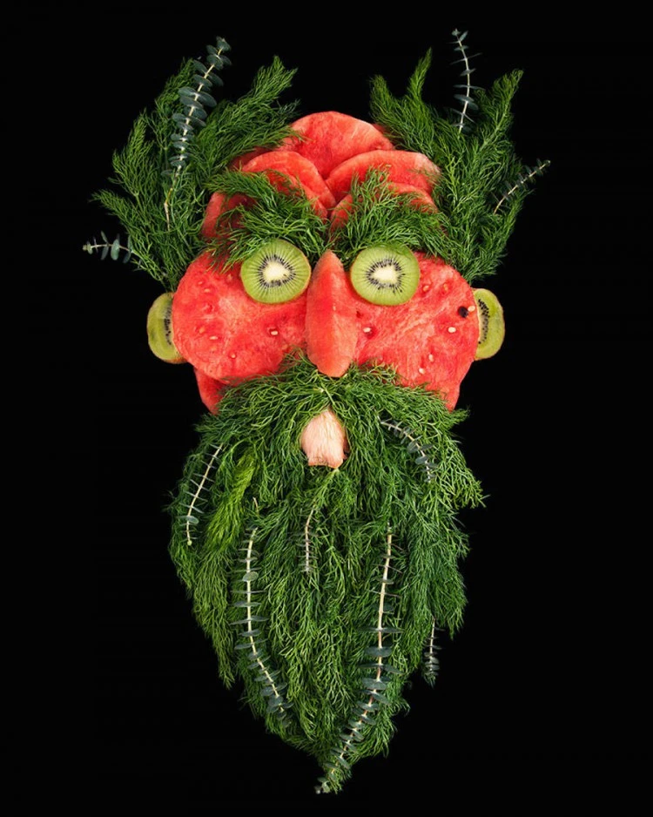
Face Perception and the FFA
Humans 🡪 Great at seeing faces in non-face objects
FFA (fusiform gyrus) plays a large role in response to face stimuli, even when they are not faces
Known as Face Pareidolia
Faces are special to primates too, but this non-face detection had yet to be studied in them
Notes:
Now on perception, which was your first unit I think
Let’s look at a very specific type of perception: the perception of faces.
Humans are great at seeing faces, even when those faces are not actual human faces. Does anyone not see faces up here? Okay cool just making sure.
Just as a reminder, the fusiform face area plays a large role in face perception,
… but interestingly it also is activated when looking at non-face stimuli that look like faces. So everyone’s FFAs are activating right now looking at these images.
But what about other animals? We know from previous research that faces are special to primates, so what if we wanted to know if they have this ability to see faces in non-face stimuli too? How might we test this?
[GIVE CHANCE TO ANSWER]

Slide 36
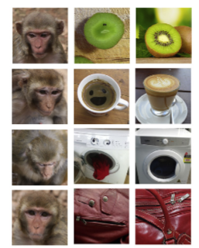
Face Perception
Taubert et al., 2017
Eye Tracking
1. Monkey Faces
2. Objects with illusory faces
3. Objects with no face
DV: Time spent looking at image and Which image was fixated on first
Notes:
MATT

Slide 37
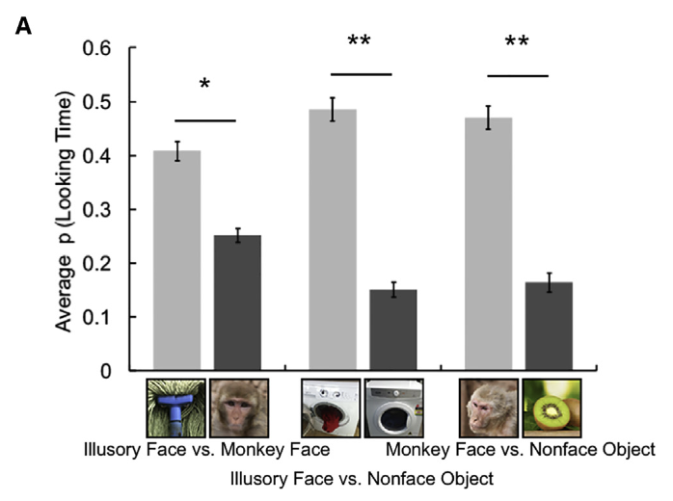
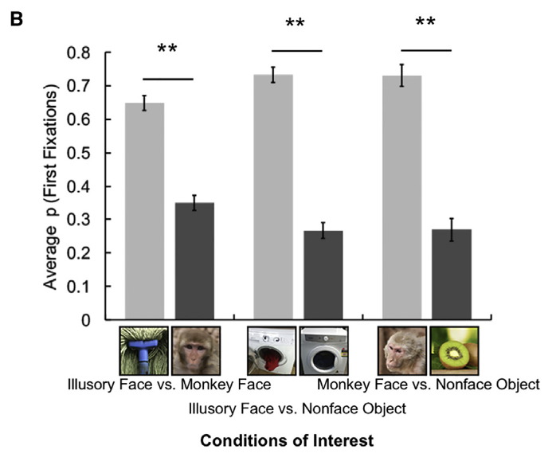
Face Perception
Macaques spent more time looking at monkey faces than non-face objects (expected)
Macaques spent more time looking at illusory faces than objects (predicted)
Macaques spent more time looking at illusory faces than monkey faces (interesting)
Notes:
A: May reflect either a response to the unusual and unexpected nature of the illusory faces [20] or an aversion to maintaining prolonged fixation on the faces of conspecifics [21], an effect frequently observed in rhesus monkeys, b

Slide 38
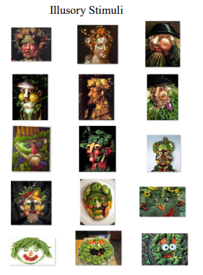
Face Perception and the FFA
Beran et al. 2017
Notes:
This study conducted in 2017 by Dr. Mike Beran at Georgia State University on Capuchin monkeys and Rhesus macaques.
Dr. Beran and team presented different stimuli to children, capuchins, and rhesus macaques and had them categorize the stimuli as either food or face.
Computer game sort of task and they measured the proportion of times that a face-like image was classified as a face.
The control stimuli are on the right. They are the same images as the test images, but they are scattered so you can’t see a face in them.
So here are the results for children.

Slide 39
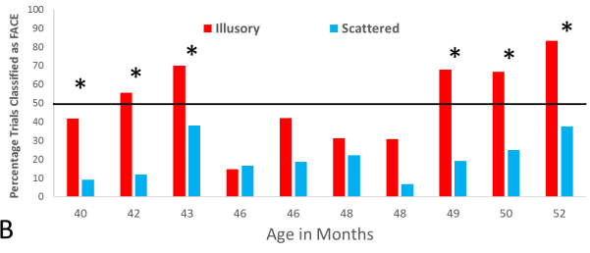
Face Perception
Beran et al. 2017
Human Children
Notes:
The y axis is the percentage of trials that were classified as a face.
That black line is the 50% threshold which is there to indicate what it would look like if the child was guessing.
X axis you have the children’s age in months.
Relatively speaking, the children were actually pretty good at classifying those food-faces as faces and they were especially good at [CLICK] Around 49 months and older. But what about the monkeys?

Slide 40
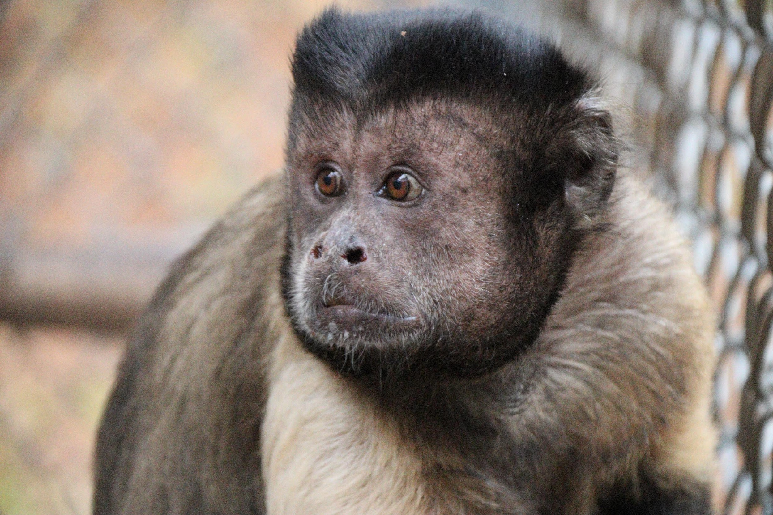
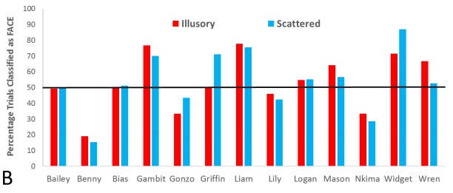
Face Perception
Beran et al. 2017
Capuchin Monkeys
Notes:
The capuchins do not show any statistically significant differences in how they classify these face-like stimuli.
We see some of the monkeys did classify them above chance, but we also see that they did so at similar levels to the control stimuli. See here here and here
One monkey did seem to do better and was classifying the face-like stimuli as faces, but it was not statistically significant. I’m also not surprised because Wren is a brilliant monkey. What about macaques?

Slide 41
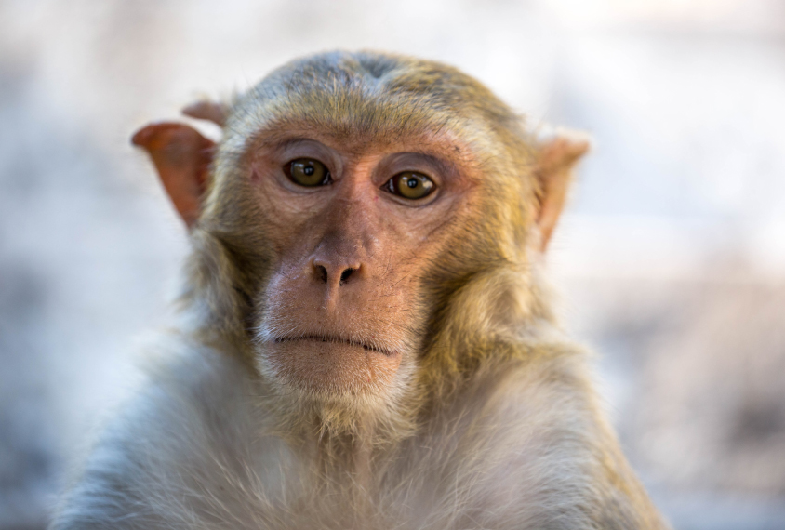
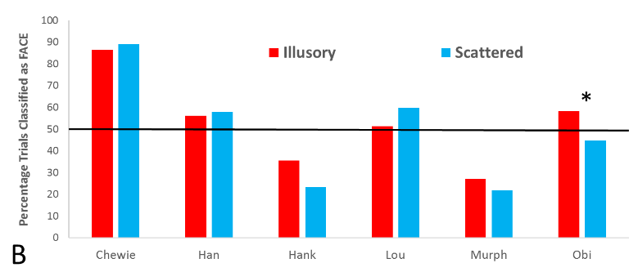
Face Perception
Beran et al. 2017
Rhesus Macaques
Notes:
The macaques also showed no difference in how often they classified each of these stimuli as being faces. Once again we see one monkey who did, but as a whole, they were relatively bad at it. So what does this tell us? [ASK QUESTION]
Answer: It can tell you a whole lot of things. For example, it seems that being able to recognize faces in non-face stimuli is a relatively unique thing amongst humans. Although some monkeys in both species were better at it than others. One thing I also didn’t explain was that the monkeys were trained to select face stimuli as a part of the experimental procedure and all the monkeys in both graphs were able to learn to classify these faces, it just took them much more time than humans who seem to do it naturally.

Slide 42
Theory of Mind
TOM = understanding another’s state of mind (Premack & Woodruff, 1978).
Perceptual – understanding of seeing and attention (e.g., joint attention).
Motivational – understanding of goals, desires, and intentions.
Informational – understanding of knowledge and beliefs.
Notes:
An idea is known as theory of mind. Theory of mind is… Humans had been thought for a long time as the only ones who were capable of theory of mind have been humans, but some reach may be showing up otherwise…How many of you think animals can have some kind of concept of theory of mind?

Slide 43
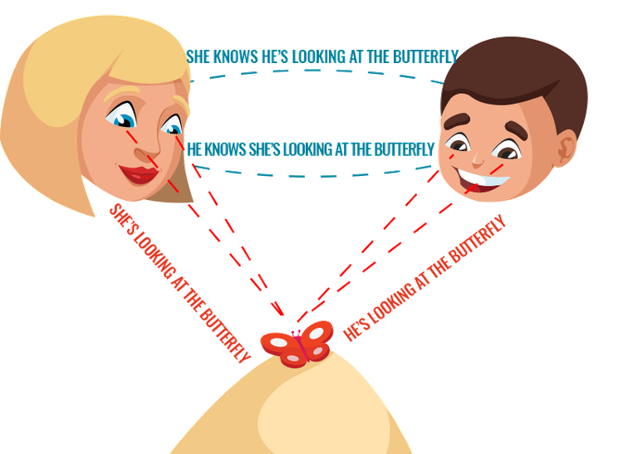
Joint Attention
Notes:
Joint Attention is a socio-cognitive skills in which two individuals use gestures or eye gaze to share attention with respect to interesting objects or events. Does anyone here have any dogs or like dogs? Well let me ask you this, if you look at something, does your dog also look at that same spot?
Well if you have or haven't had that experience, I will tell you that dogs are very good at picking up on eye gaze and also looking in that same direction. But is that something that is innate to them or is it something else? For example, domestication, so a question becomes are dogs just good at this because their evolution is intertwined with living with humans?

Slide 44
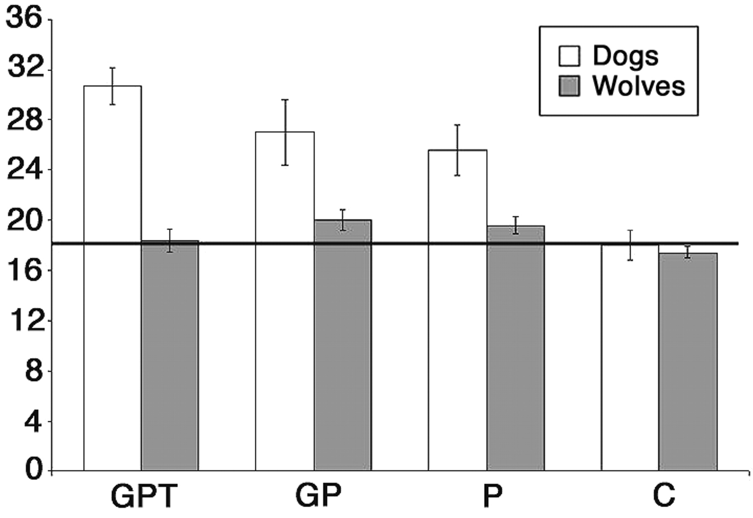
Joint Attention: Dogs and Wolves
Hare, B., Brown, M., Williamson, C., & Tomasello, M. (2002). The domestication of social cognition in dogs. Science, 298(5598), 1634-1636.
Notes:
So one group of researchers wanted to look at this more closely. So they took wolves and dogs and gave them a choice between two bowls were the subject could not see the food. The experimental condition were as follows:
The following social cues were used to indicate the food's location: (i) Gaze + Point + Tap cue (GPT): The experimenter looked toward the baited bowl while extending his/her cross-lateral arm and tapping on the bowl for 3 to 5 s, which made a small noise. (ii) Gaze + Point cue (GP): identical to GPT, except that the tapping was replaced with pointing at the baited bowl (the index finger was 10 to 15 cm from the bowl). (iii) Point cue (P): identical to GP, except that no gaze cue was given (the experimenter looked at the subject). (iv) Control cue (C): the experimenter gave no cue (looked straight ahead)
The results here show…
It is pretty clear that domestication plays a huge role in animals using eye-gaze to learn something about their environment. This is also a very good example of the things you can learn through comparative studies. Here we see that domestication has influences on an animals sensitivity to social cues.
Even so, in humans, many believe that Eye gaze is an important social signal, providing information about an individual’s perception, and subsequently, knowledge of the external world as well as their emotions and mental states. Which brings me to the next topic…

Slide 45
Theory of Mind: Chimpanzees and Ravens
https://www.youtube.com/watch?v=1s0dO_h7q7Q
https://www.youtube.com/watch?v=Sng1oV_uDzM
Notes:
Another approach researchers take is just observing the animals behavior in the wild, like they did here with the Chimpanzees and Ravens…

Slide 46
Empathy
The ability to understand and share feelings with another.
Notes:
So some other researchers take another approach to looking at this question… And that is looking at empathy which is the ability to understand and share feelings with another.
Now you can imagine that empathy would be very difficult to measure and study in animals in which we cannot ask them.

Slide 47
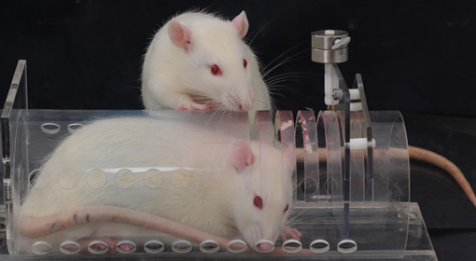
Empathy in rats?
Empathy and pro-social behavior in rats (Bartal, Decety, & Mason, 2013)
Notes:
But some experimenters have found some clever ways to try and measure empathy in animals. In this study by Bartal…

Slide 48
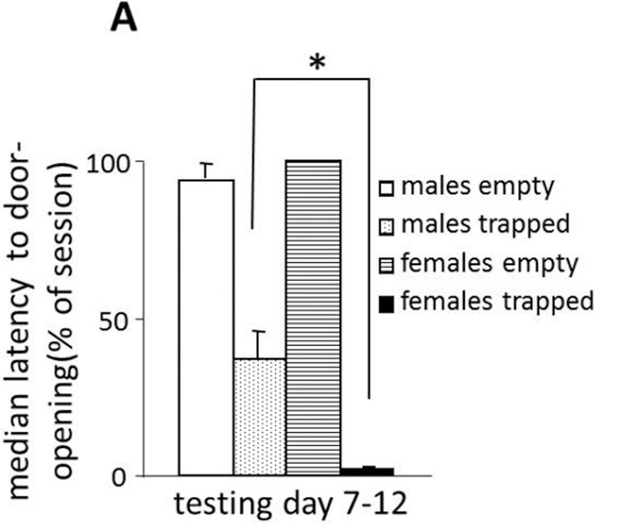
When there was a conspecific in the trap, both males and females were faster to open the door then when there was nothing there or an object.
Females were significantly faster than the males.
Notes:
Explain the graph.
On top of this, the experimenters ran a couple more studies. Rats did not open empty or object-containing restrainers. They freed cagemates even when social contact was prevented. When liberating a cagemate was pitted against chocolate contained within a second restrainer, rats opened both restrainers and typically shared the chocolate.
So given the videos we watched and these experiments we covered. Do you think animals have theory of mind?

Slide 49
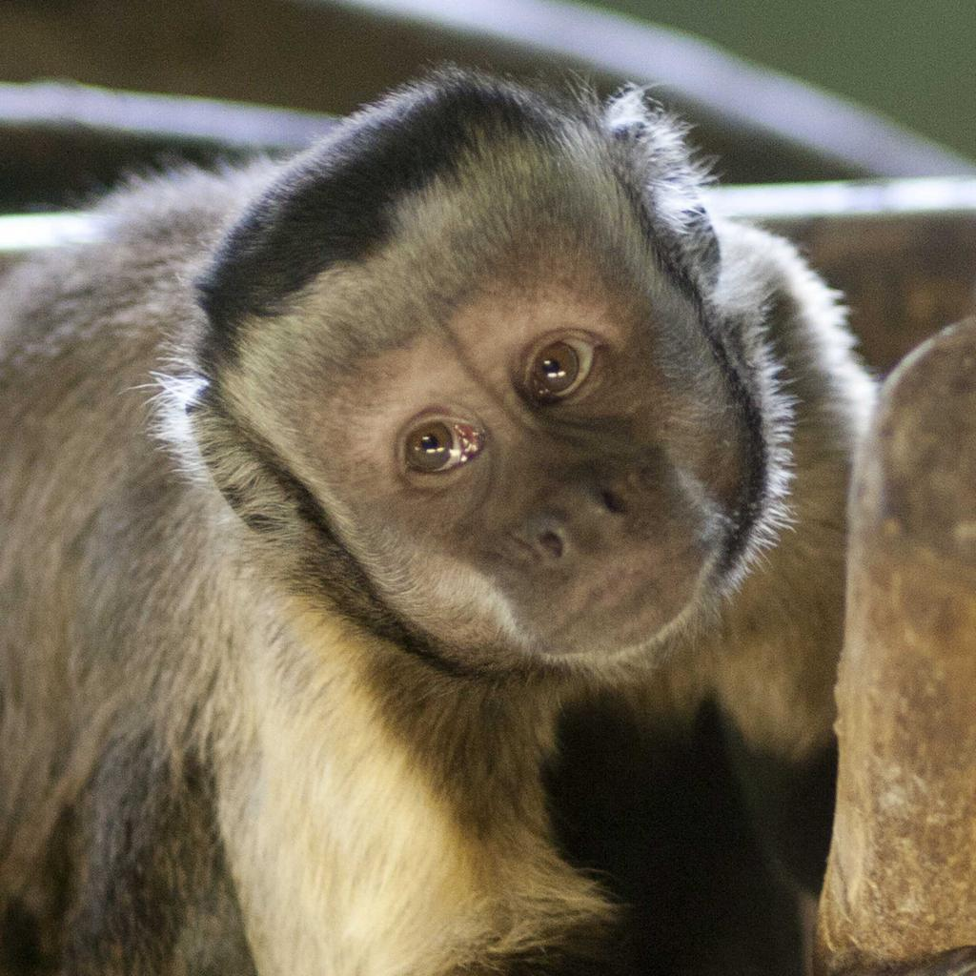
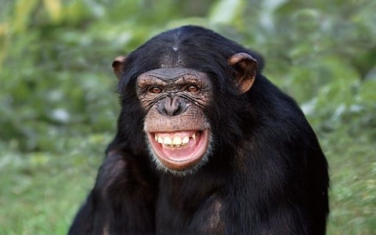
Comparative Cognition
Primates
Cebus [Sapajus] apella
Pan troglodytes

Slide 51
Inequity aversion: Capuchins
https://www.youtube.com/watch?v=meiU6TxysCg&t=158s

Slide 52
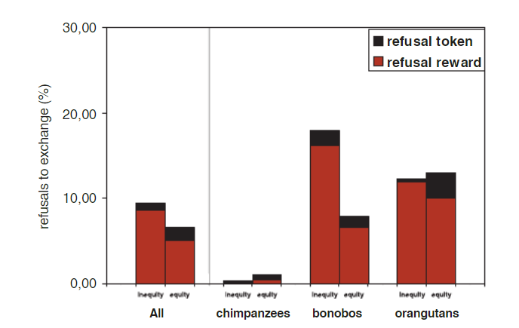
Inequity aversion: Great Apes
Bräuer, J., Call, J., & Tomasello, M. (2009). Are apes inequity averse? New data on the token‐exchange paradigm. American Journal of Primatology: Official Journal of the American Society of Primatologists, 71(2), 175-181.

