Slide 1
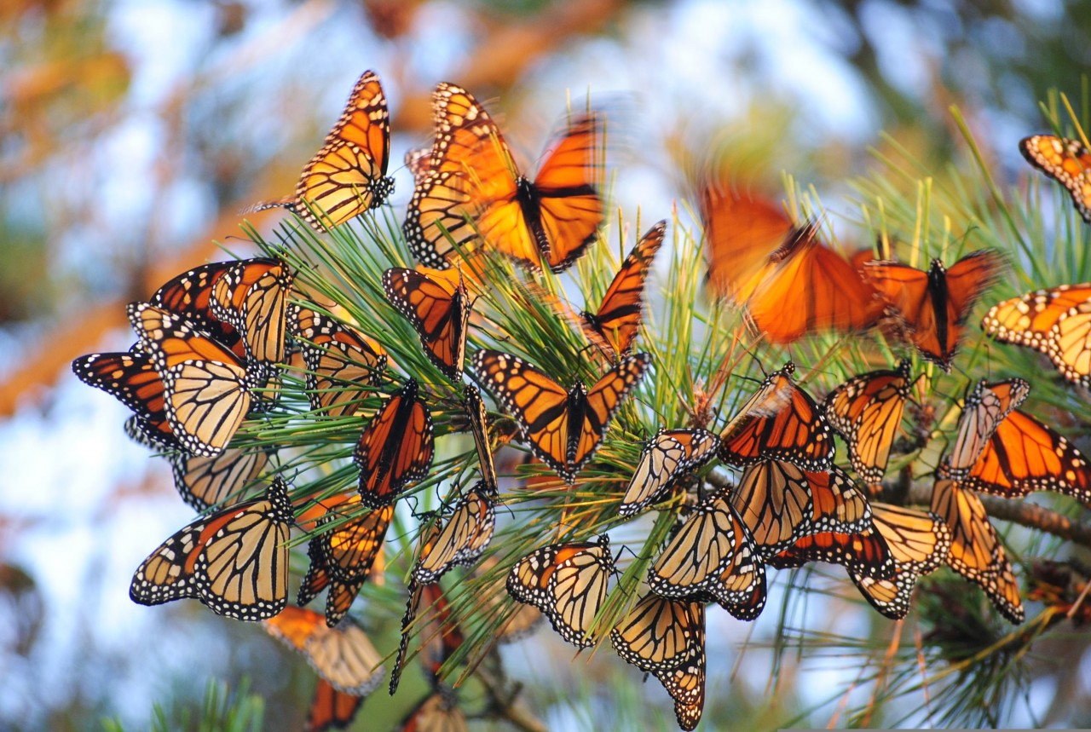
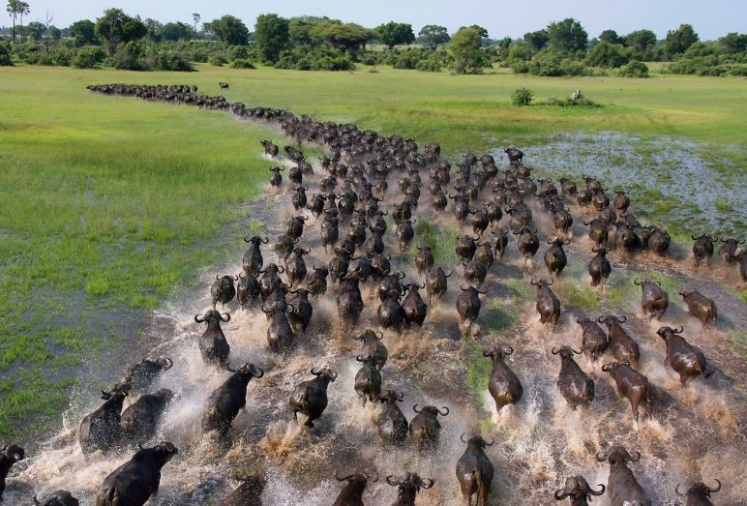
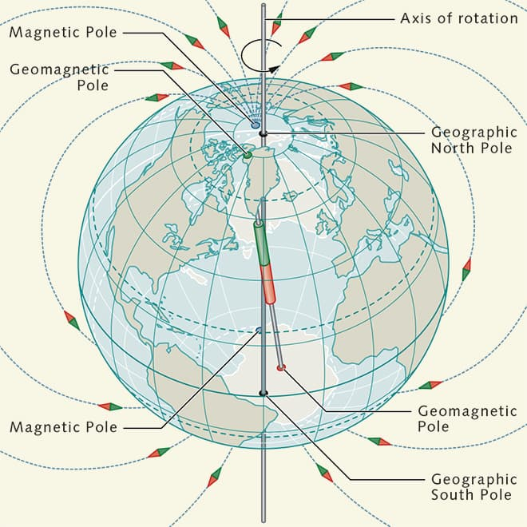
Animals on the Move
Navigation, Migration, and Movement
Matt Babb
Georgia State University

Slide 2
Migration
What comes to mind when you think of migration?
What is migration?

Slide 3
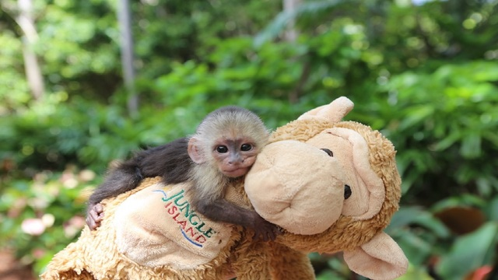
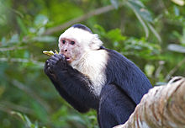
Animal Movements
Migration: seasonal movement of animals from one region to another.
  Usually involves a return
Dispersal: permanent movement of animals to a new region
  Common in primates as juveniles get older

Slide 4
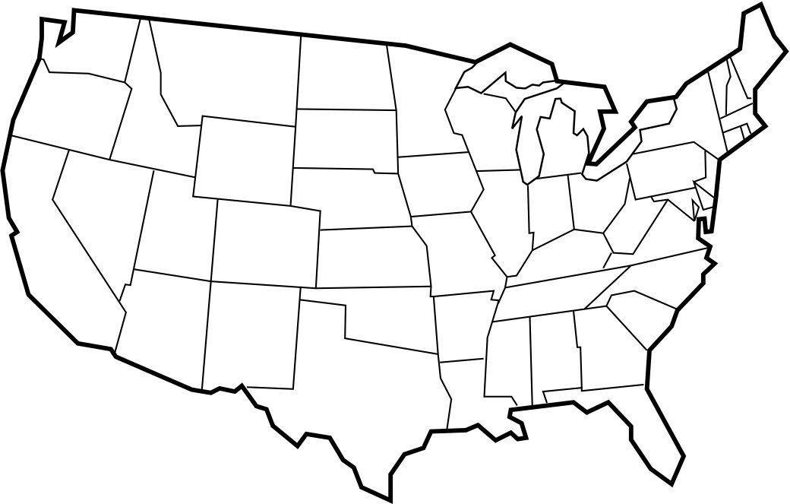
Emigration vs Immigration
Immigration: process of an animal moving to a new habitat, region, or location.
Emigration: process of an animal moving away from a previous habitat, region, or location
Immigration
Emigration

Slide 5
Animal Movements
Immigration, and Emigration can be classified under both:
Dispersal
Migration

Slide 6
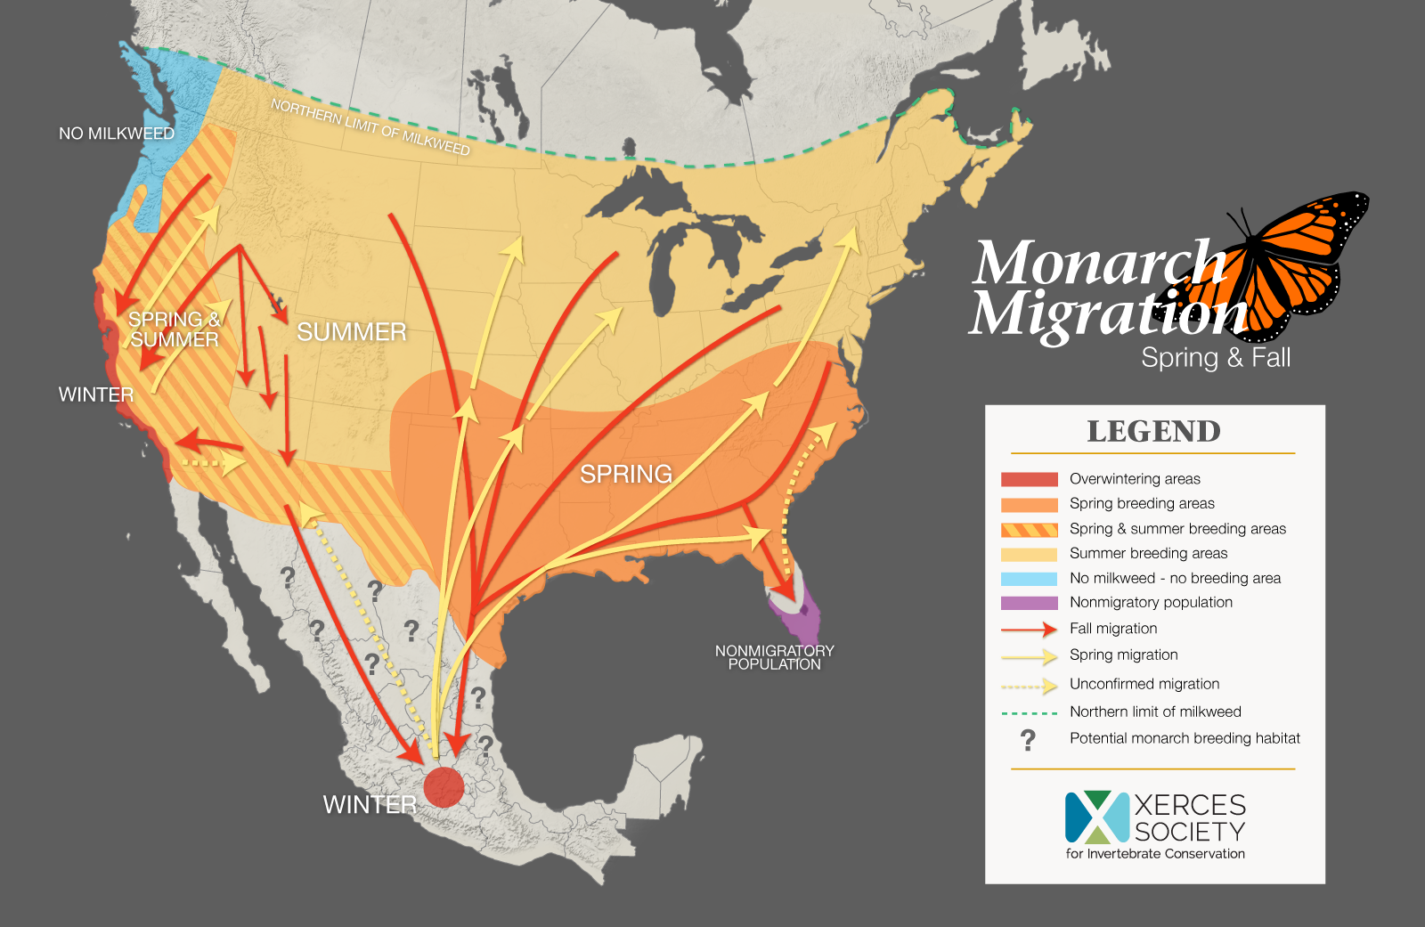
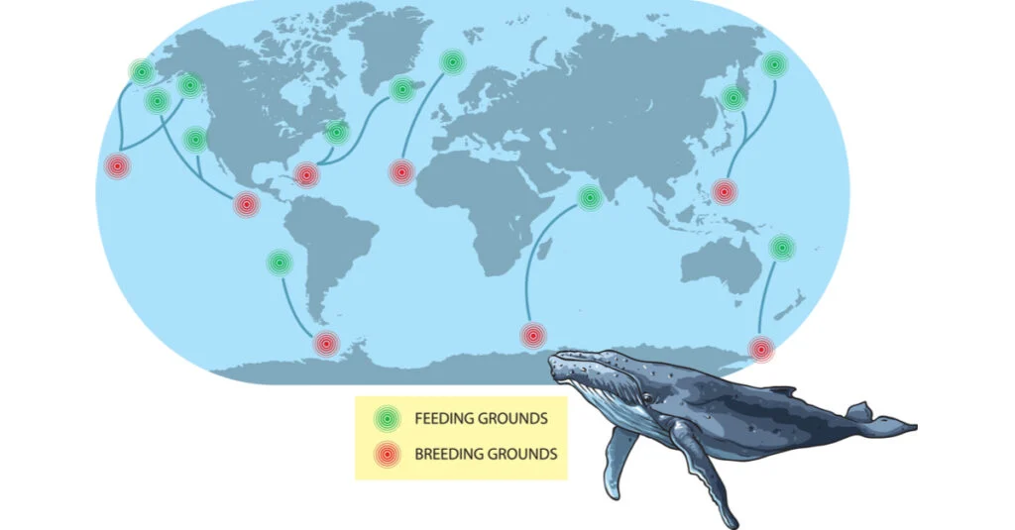
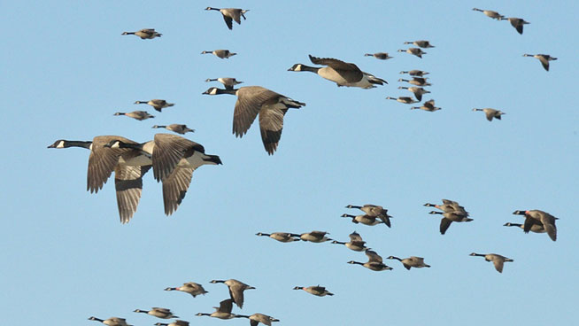
Migration
Examples of Migration?

Slide 7


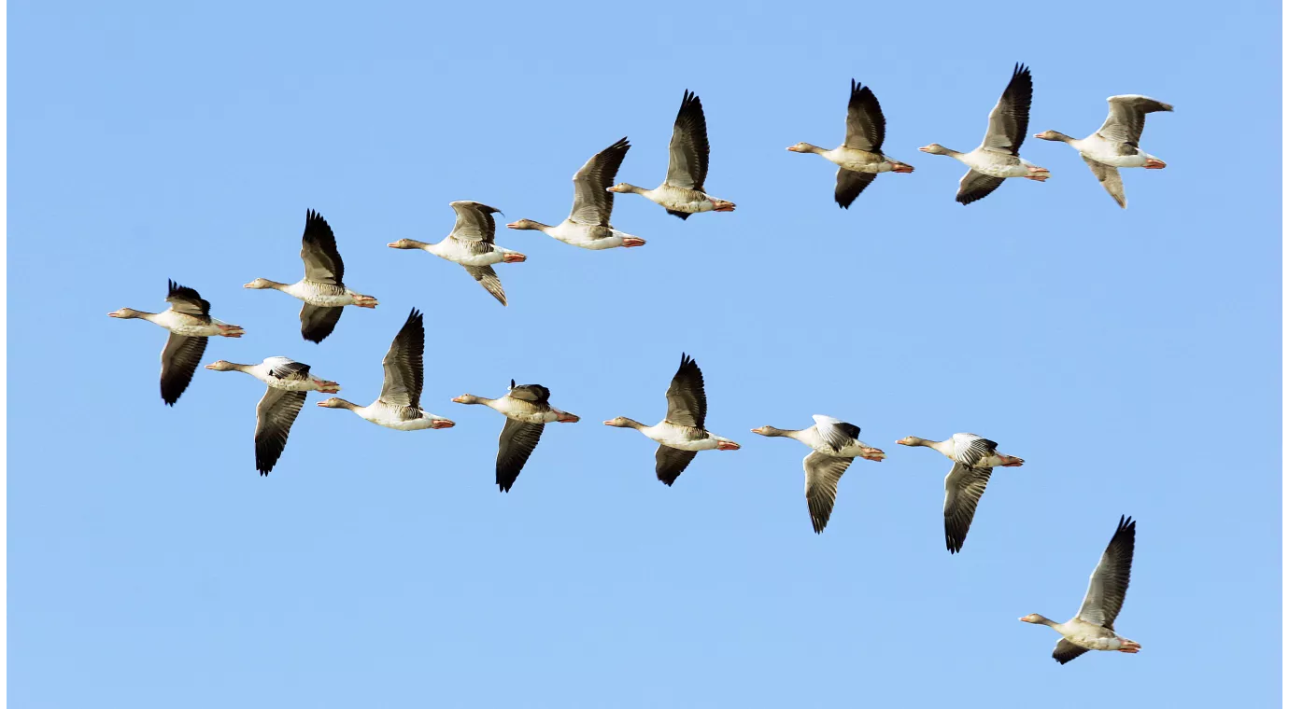
Why Move?
Why might animals need to move?
  Lack of food or resources
  Climate becomes too cold or too hot
  Avoid Predators
  Find a Mate/Reproduce
  Natural Disaster
  Overpopulation
  Human encroachment/pollution

Slide 8
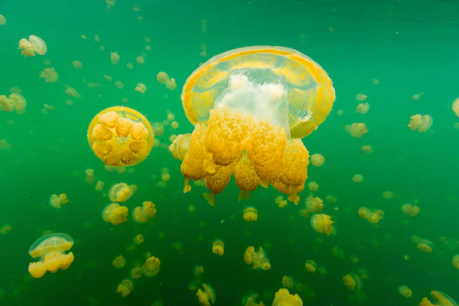

Golden Jellyfish
Daily Migration
  Sunrise: Swim to surface
  Sunset: Swim to deeper water
Symbiotic Relationship
  Zooxanthellae: algae-like organisms
  Provide jellies with energy from photosynthesis
Advantages
  Predators in the shade
Ecosystem Impact
  Daily movement stirs the water churning nutrients

Slide 9

Golden Jellyfish

Slide 10

Golden Jellyfish

Slide 11
Golden Jellyfish

Slide 12
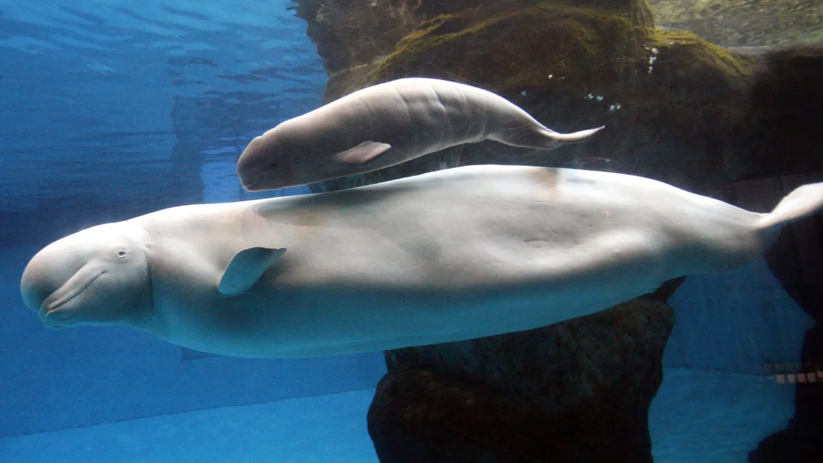
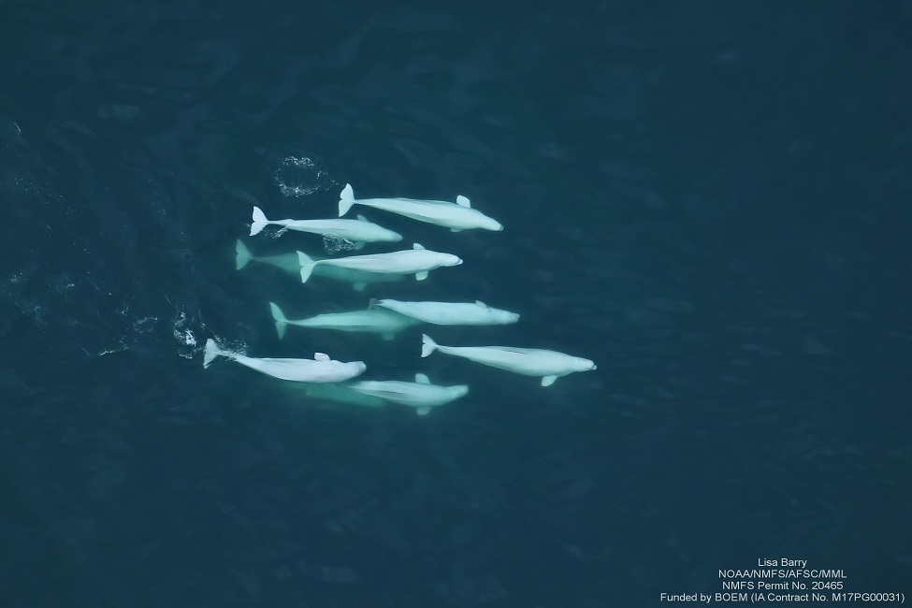
Beluga Whale
Annual Migration
  Summer melts sea ice
  Swim toward warm shallow estuaries
  ~ 6,000 km (3,800 miles)
Only some populations migrate
Why?
  Safer for newborn calves
  Stimulates metabolism
  Avoids Orcas (predator)
Climate Change
  Migration strategy was related to sea-surface temperature conditions (Bailleul et al., 2012)
Notes:
O'Corry-Crowe, G. "Beluga Whale Delphinapterus leucas". Encyclopedia of Marine Mammals. pp. 94–99.
Bailleul, F., Lesage, V., Power, M., Doidge, D. W., & Hammill, M. O. (2012). Migration phenology of beluga whales in a changing Arctic. Climate Research, 53(3), 169-178.

Slide 13
Types of Migration
Obligatory Migration:
  Migration that occurs at a predictable time in response to a predictable stimuli
  “Hard-Wired”
  Regular, Consistent, Predictable
    Examples: Mating Season, Avoid the Cold
Facultative Migration:
  Migration that occurs in response to current environmental conditions
  Sometimes occurs, sometimes doesn’t
  irregularity, inconsistency, and unpredictability
    Examples: Dry season, El niño year
Notes:
Newton, I. Obligate and facultative migration in birds: ecological aspects. J Ornithol 153, 171–180 (2012). https://doi.org/10.1007/s10336-011-0765-3

Slide 14
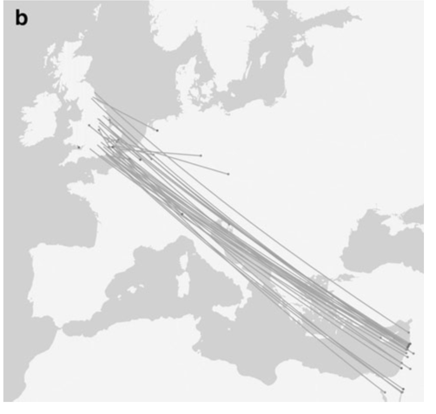
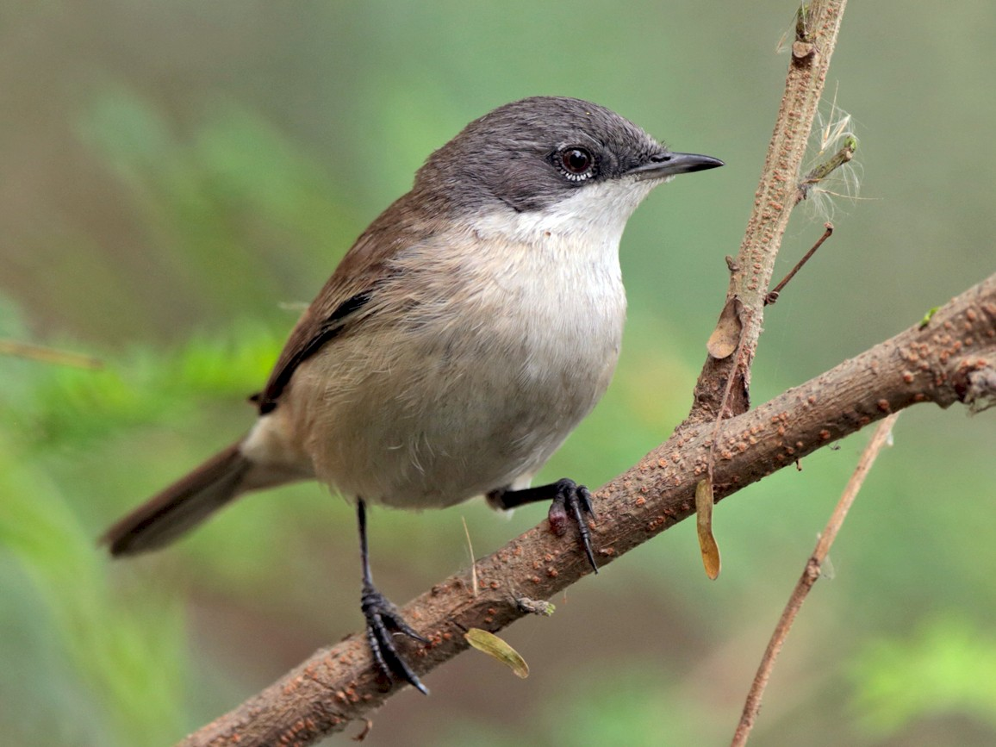
Obligatory Migrants
Features:
  Individuals leave before food resources are absent
  Timing is consistent year to year
  Similar behavior each year
  Tight genetic control of Migration
  ~~Long Distance~~ (not required)
Example: Lesser Whitethroats
Wernham et al. (2002)
Notes:
Newton, I. Obligate and facultative migration in birds: ecological aspects. J Ornithol 153, 171–180 (2012). https://doi.org/10.1007/s10336-011-0765-3
Wernham CV, Toms MP, Marchant JH, Clark JA, Siriwardena GM, Baillie SR (2002) The migration atlas: movements of the birds of Britain and Ireland. T & AD Poyser, London

Slide 15
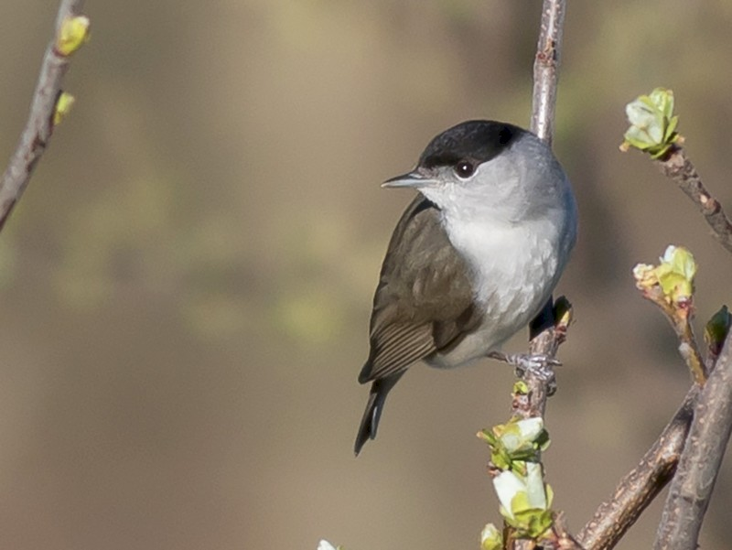
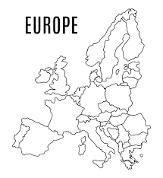



Genetic Basis of Migration
Example: European Blackcaps
Evidence of Genetic Basis of Migration
Migration Location
  Some migrate SW
  Others migrate SE
  Hybrids migrate S
2. Migration Timing
- Correlation between parent and offspring migration timing
- Early parents have Early offspring

Slide 16
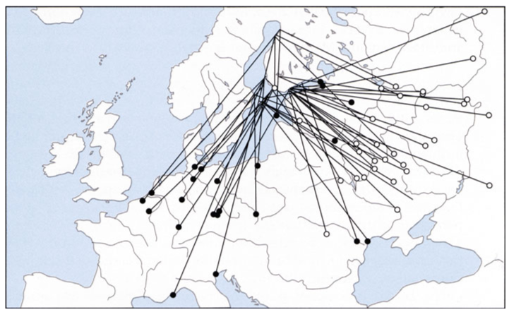
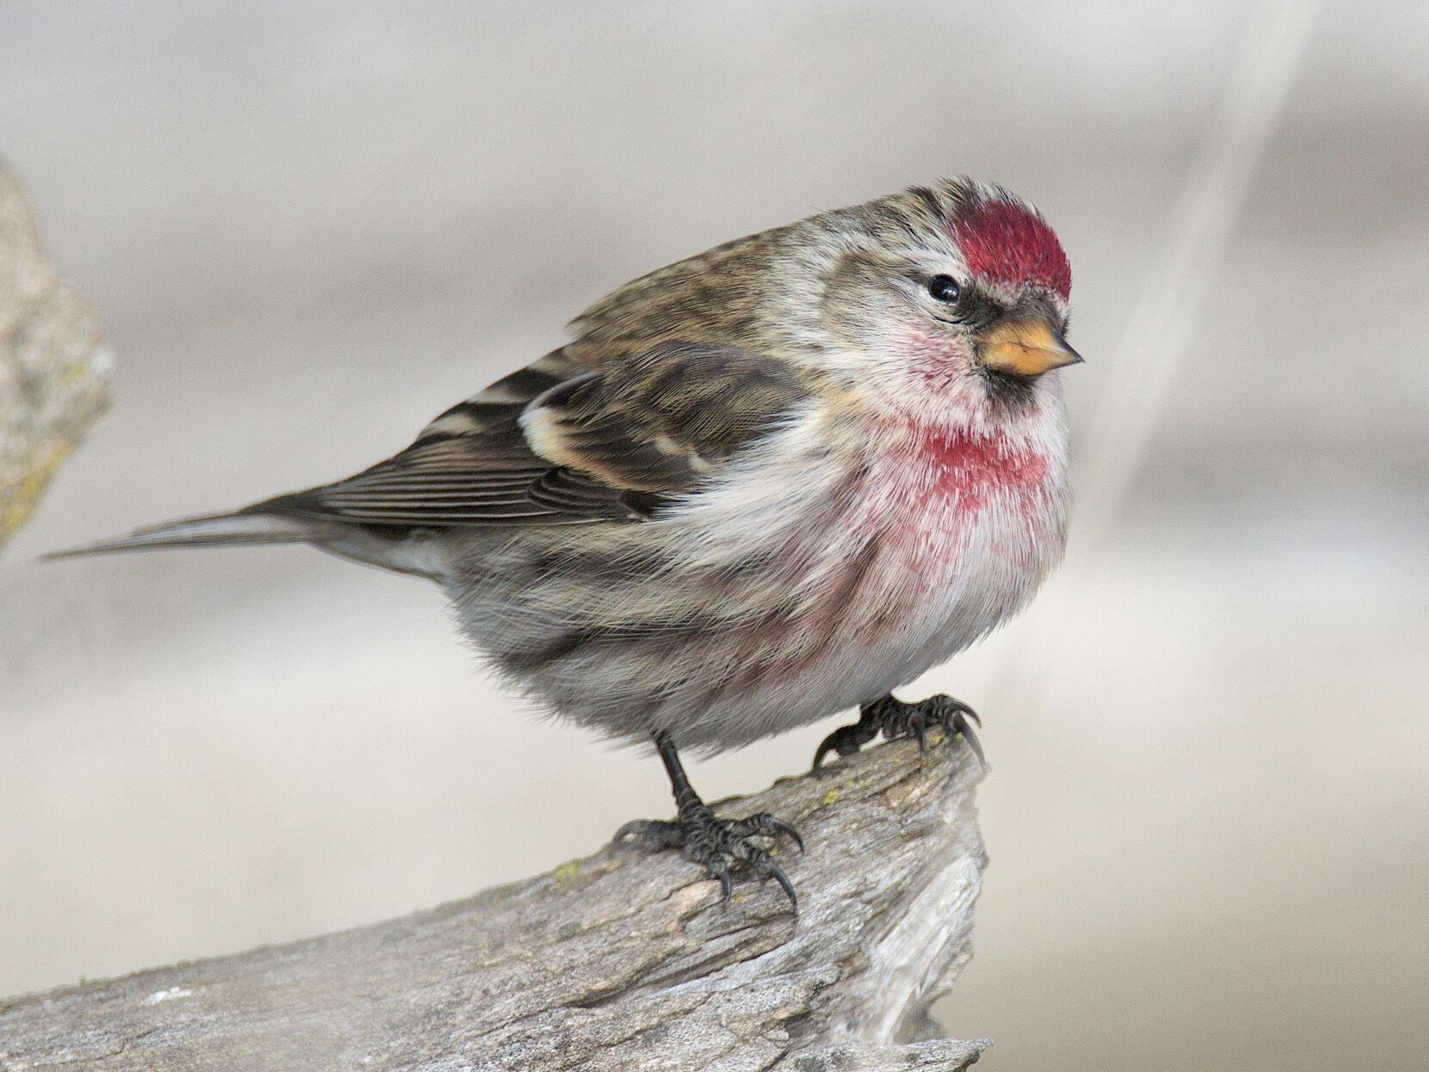
Facultative Migrants
Features:
  Proportions of a population that migrate vary year-to-year
  Distance migrated and timing are variable
  Individual behavior varies
  Usually a direct response to a lack of food
  Less genetic control of migration
Example: Common Redpolls
Zink and Bairlein (1995)
Winter 1965-1966
Winter 1972-1973
Notes:
Newton, I. Obligate and facultative migration in birds: ecological aspects. J Ornithol 153, 171–180 (2012). https://doi.org/10.1007/s10336-011-0765-3
Zink G, Bairlein F (1995) Der Zug Europa¤ischer Singvo¤gel. AULA-Verlag, Wiesbaden

Slide 17


Why NOT Move?
What are costs associated with migration?
  Physically Demanding / Energy cost
  Lack of Food or Water on Journey
  Time Costs
  Potential new Predators
What are alternatives to migration?
  Hibernation
  Estivation

Slide 18
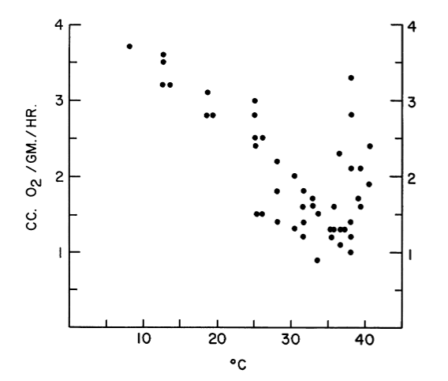
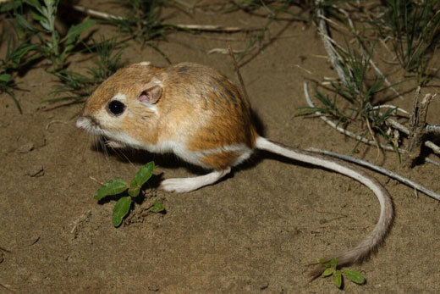
Estivation of Kangaroo Mice
Desert Ecosystems
Nocturnal
Metabolically derives water from food it eats
Hibernate and Estivate
Oxygen Consumption
Ambient Temperature (C)

Slide 19
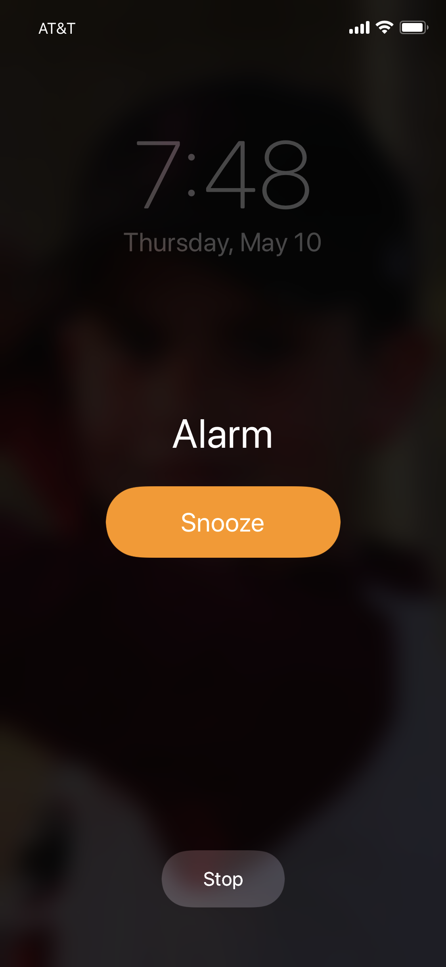

Is it time to go?
How does an animal know when its time to move?
  Internal Signals
    Hormones – mating and hunger
    Metabolic patterns
    Circadian Rhythms
  External Signals
    Daylight
    Temperature
    Resource availability
    Population Density

Slide 20
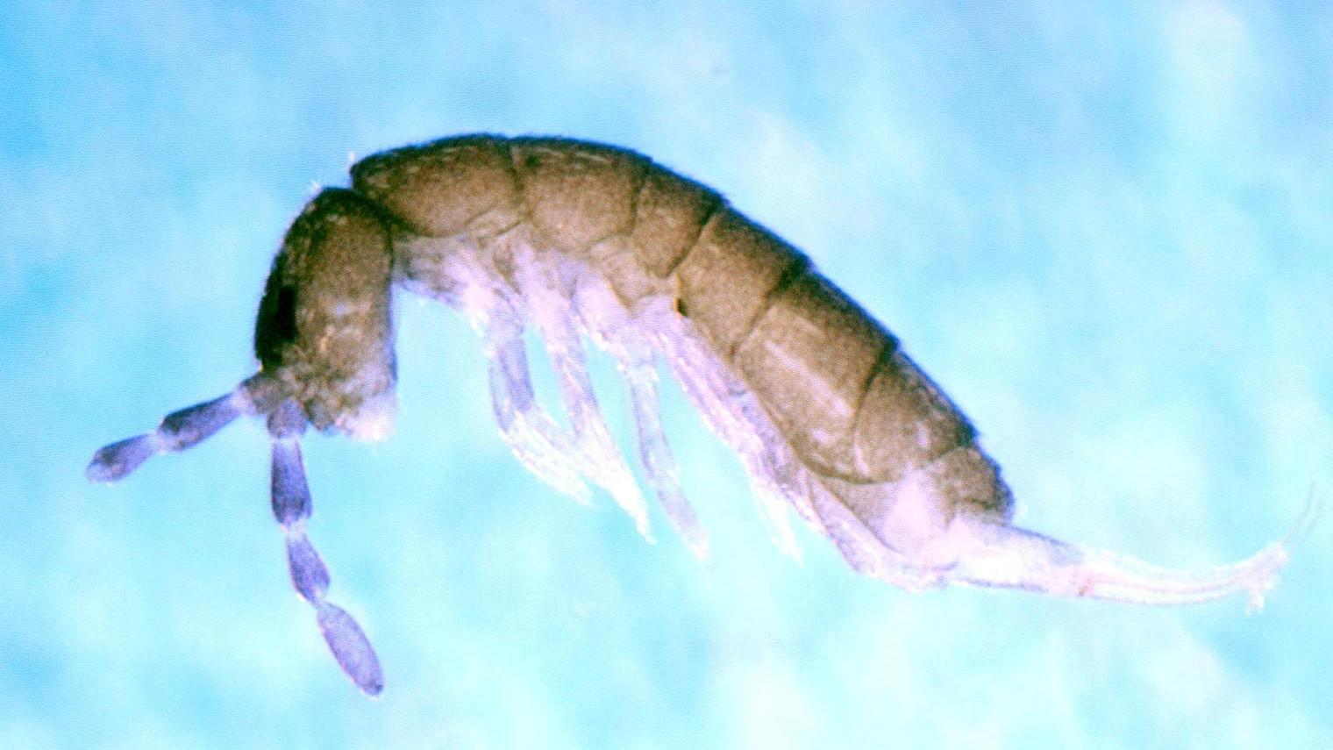
Springtails
Dispersal, not Migration
Research Question: Can overcrowding cause dispersal?

Slide 21
Springtails
Research Question: Can overcrowding cause dispersal?

Slide 22
Springtails
Low population densities had very little dispersal
High population densities had very high dispersal
Number Dispersed
Number of Springtails

Slide 23
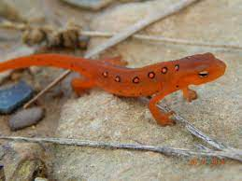
Red-Spotted Newt
Low population densities had little dispersal
High population densities had high dispersal
% Migrated to Land
Low Medium High

Slide 24
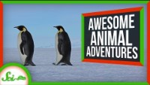
Examples of Migration

Slide 25
How?!

Slide 26
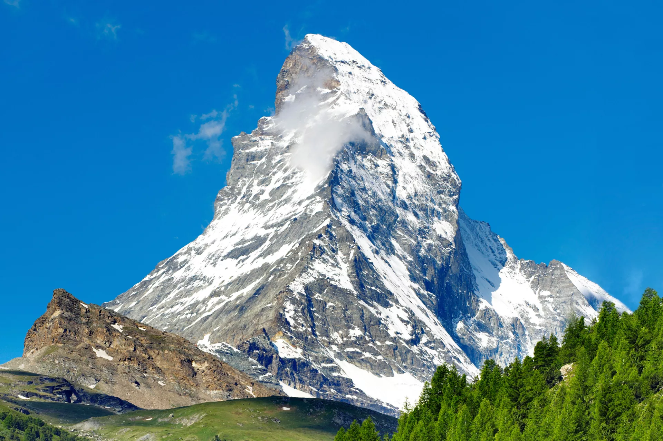
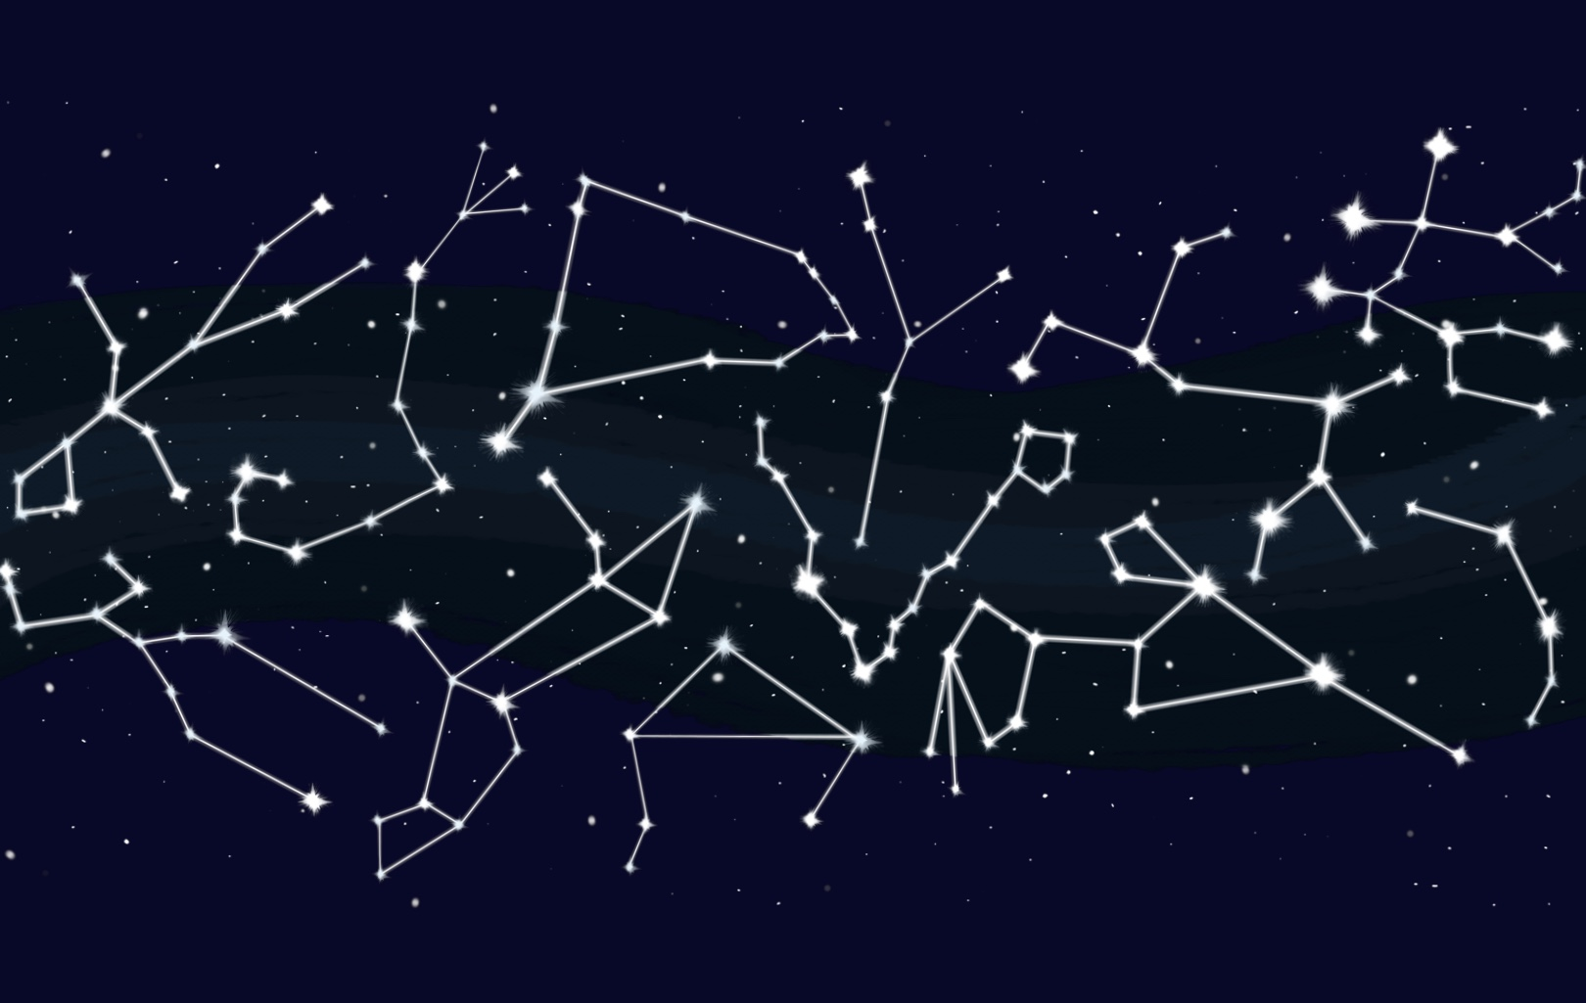
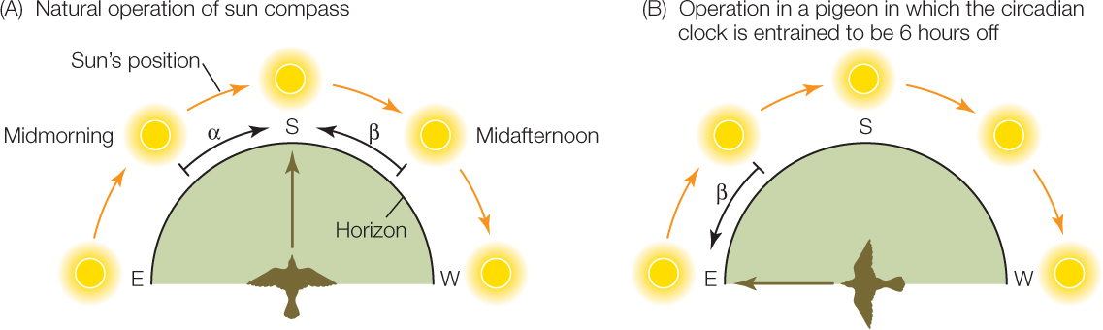
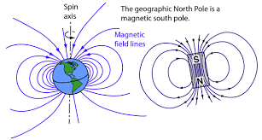
How do animals migrate?
What are some possible ways animals know where to go?
  Mental Maps
  Olfaction
  Auditory Cues
  Visual Landmarks
  Star Compass
  Sun Compass
  Magnetic Field

Slide 27
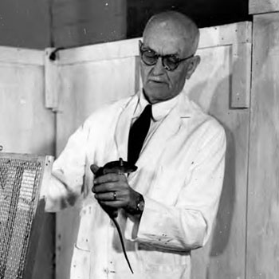
Edward Tolman, 1946
Behaviorist
  how environmental factors affect observable behavior
Cognitive Revolution
Cognitive Maps
  Mental representation that an individual uses to acquire, maintain, and retrieve information about the relative locations and attributes of phenomena in their environment
    (Kaplan et al., 2017)
Notes:
Kaplan, R., Schuck, N. W., & Doeller, C. F. (2017). The role of mental maps in decision-making. Trends in Neurosciences, 40(5), 256-259.

Slide 28
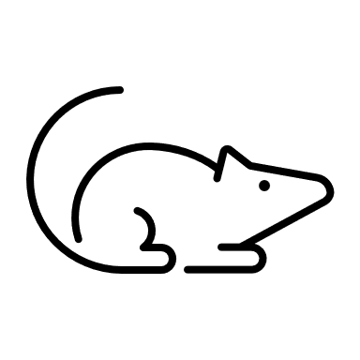

Response-Learning
Place-Learning
N
N
Turn Left
Turn Left
E
W
E
W
S
S
N
N
E
W
E
W
Turn Left
Turn Right
S
S
Tolman et al., 1946

Slide 29
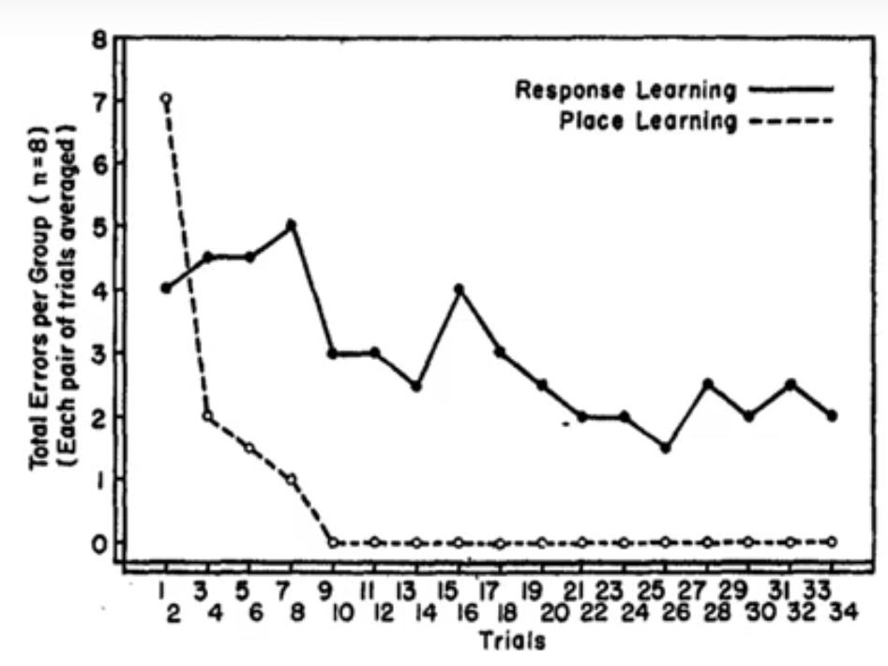
Cognitive Map Results

Slide 30
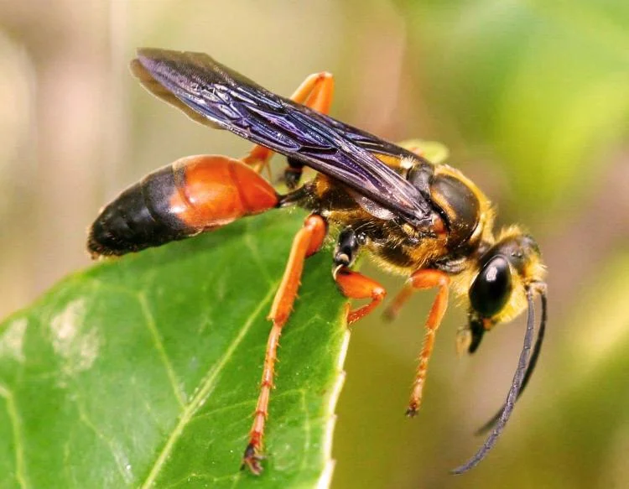
Niko Tinbergen, 1972
Ethologist
  scientific study of animal behavior, usually with a focus on behavior under natural conditions, and viewing behavior as an evolutionarily adaptive trait
Digger Wasp Experiment
  Dig burrows to hold larva
  Female flies out to find food
  Brings food back to burrow

Slide 31

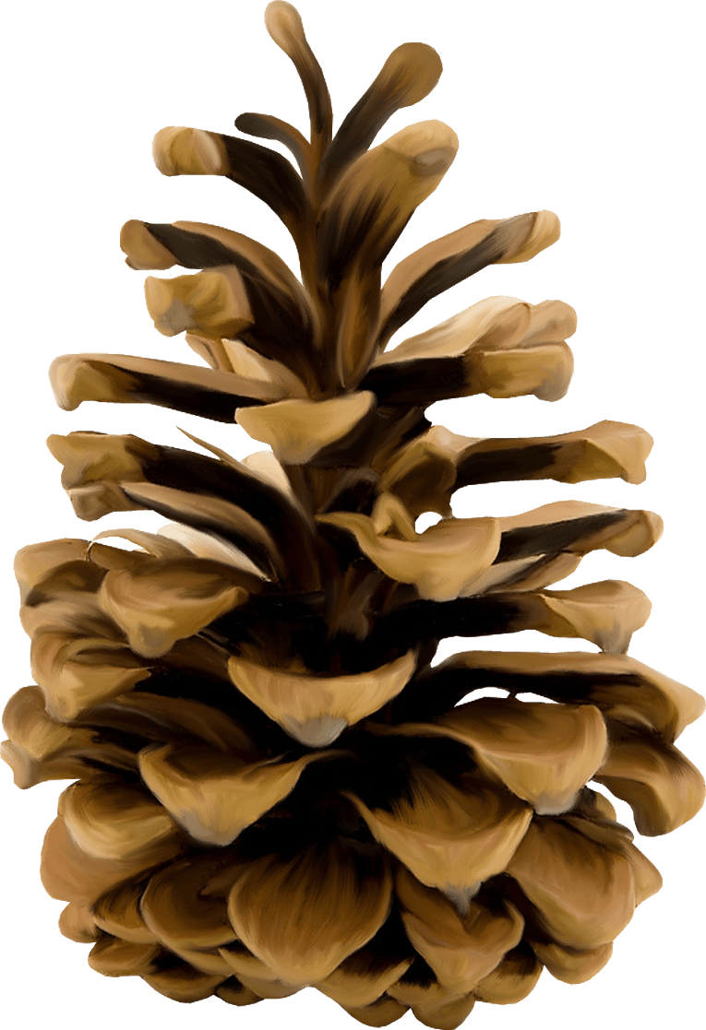

Digger Wasps use Landmarks

Slide 32


Digger Wasps use Landmarks
What
the
…

Slide 33
Digger Wasps were using visual cues to remember the location of their burrow
Tinbergen tried all different kinds of stimuli
Even tried olfactory cues, they didn’t work
He always pranked the wasp

Slide 34
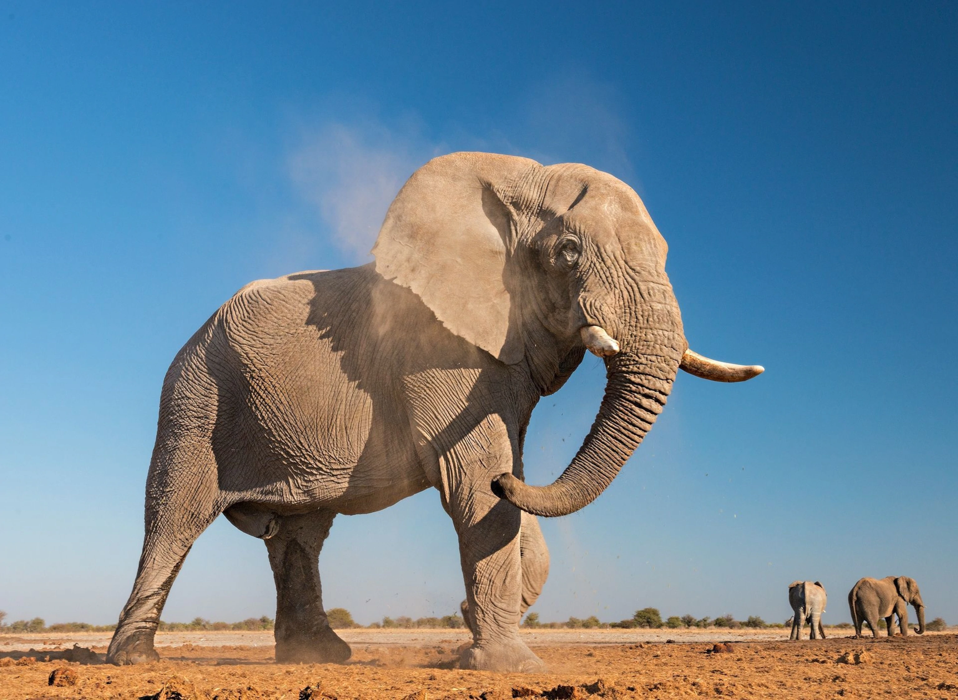
African Elephants
Partial facultative migrants
  What does that mean?
Unpredictability of African Savanna
Dry Season and Wet Season
  Migrate in response to seasonal rainfall (Purdon et al., 2018)
Groups migrate some years but not others
Notes:
Purdon, A., Mole, M.A., Chase, M.J. et al. Partial migration in savanna elephant populations distributed across southern Africa. Sci Rep 8, 11331 (2018). https://doi.org/10.1038/s41598-018-29724-9

Slide 35
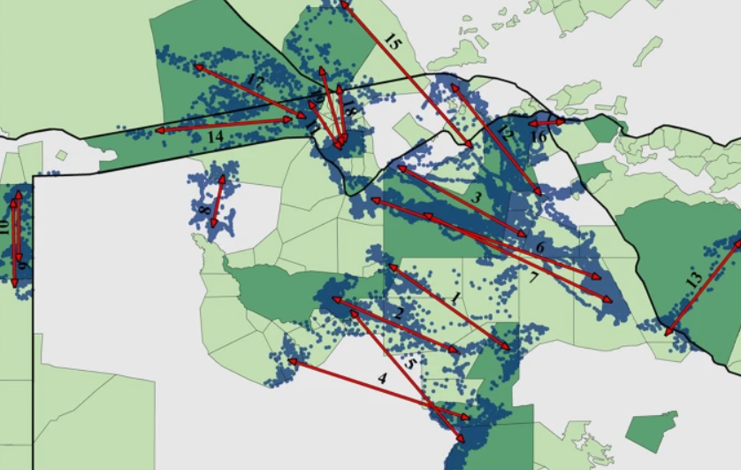
African Elephants
Purdon et al., 2018
Notes:
Purdon, A., Mole, M.A., Chase, M.J. et al. Partial migration in savanna elephant populations distributed across southern Africa. Sci Rep 8, 11331 (2018). https://doi.org/10.1038/s41598-018-29724-9

Slide 36
Infrasound Cues
Human Hearing Range:
  20 Hz – 20,000 Hz
Elephant Communication
  14 Hz – 35 Hz
  120 decibels
    Loud but we cannot hear it
Communicate using infrasound
0 Hz
20 Hz
20 kHz
200 kHz
Infrasound
Ultrasound

Slide 37
Infrasound Cues
Infrasound:
  Longer wavelengths
  Sound travels further distance
  Elephants have complex social organizations but must separate when the herd becomes too large
0 Hz
20 Hz
20 kHz
200 kHz
Infrasound
Ultrasound

Slide 38
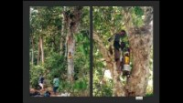
Infrasound Cues

Slide 39
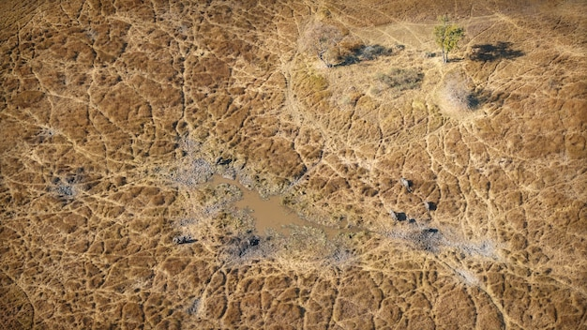

African Elephants
1-5 km
Notes:
Coordinate Movements

Slide 40
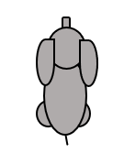
African Elephants
Notes:
Estrous or Distress

Slide 41
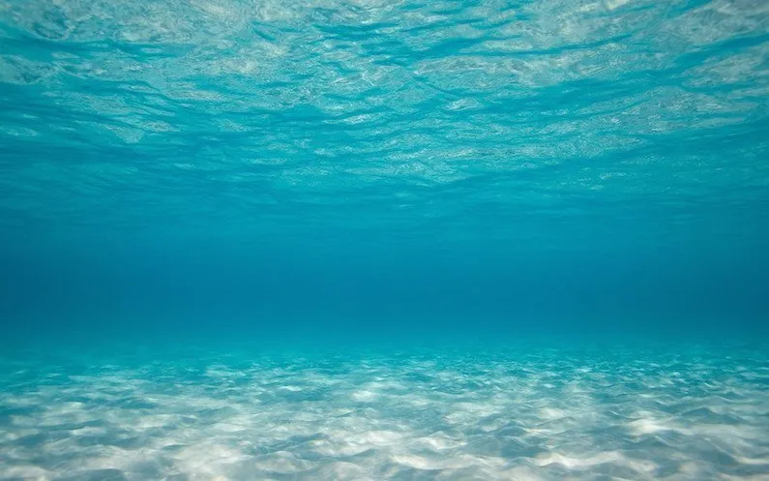
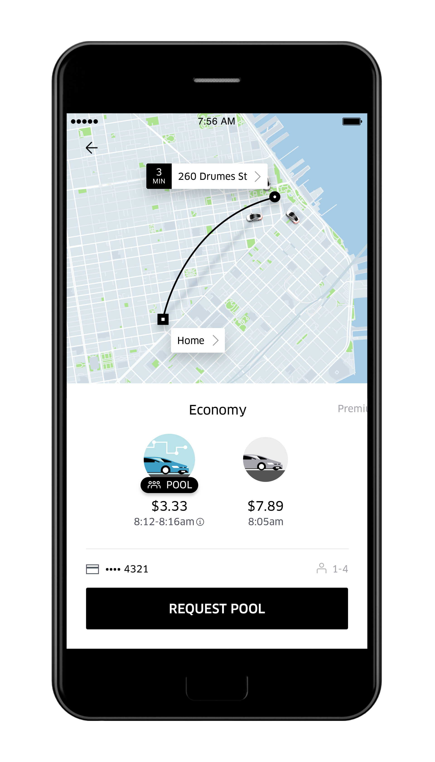


Sc
Pacific Ocean
Atlantic Ocean

Slide 42
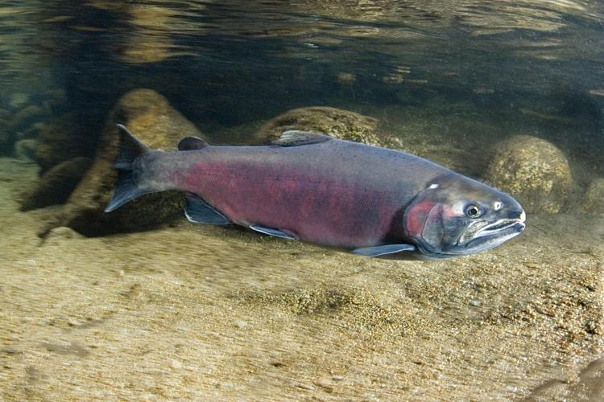
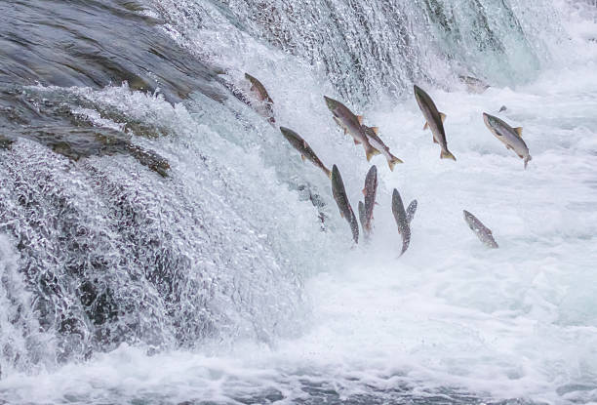
Coho Salmon
Anadromous fish
  Spawn in freshwater streams
  But live in the ocean
~1 year after birth, they make it to the ocean
3 years of age, they return to the same river where they were born to spawn
How do they do that?
  Olfactory Cues
  Magnetic Navigation
Notes:
Bett, N. N., & Hinch, S. G. (2016). Olfactory navigation during spawning migrations: a review and introduction of the Hierarchical Navigation Hypothesis. Biological Reviews, 91(3), 728-759.
Hasler, A., Scholz, A.T. & Horrall, R.M.(1978). Olfactory imprinting and homing in salmon. American Scientist 66, 347 – 355

Slide 43


Coho Salmon Experiment
4 Test Groups
Imprinted
Imprinted
Non-imprinted
Non-imprinted
Notes:
Bett, N. N., & Hinch, S. G. (2016). Olfactory navigation during spawning migrations: a review and introduction of the Hierarchical Navigation Hypothesis. Biological Reviews, 91(3), 728-759.
Hasler, A., Scholz, A.T. & Horrall, R.M.(1978). Olfactory imprinting and homing in salmon. American Scientist 66, 347 – 355

Slide 44

Coho Salmon Experiment
4 Test Groups
Released in the water at spawning age and measured where they went with GPS satellite tracking
Imprinted
+ Chemical
Imprinted
+ no Chemical
Non-imprinted with Chemical
Non-imprinted with no Chemical
Notes:
Bett, N. N., & Hinch, S. G. (2016). Olfactory navigation during spawning migrations: a review and introduction of the Hierarchical Navigation Hypothesis. Biological Reviews, 91(3), 728-759.
Hasler, A., Scholz, A.T. & Horrall, R.M.(1978). Olfactory imprinting and homing in salmon. American Scientist 66, 347 – 355

Slide 45
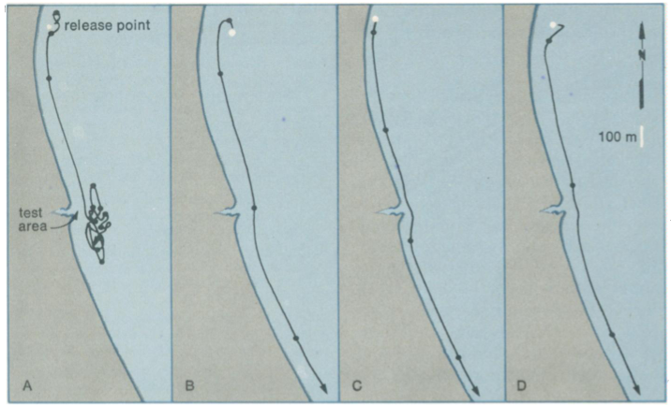
Coho Salmon Experiment
Hasler et al., 1978
Test Site with Chemical Release
Imprinted with Chemical
Imprinted with no Chemical
Non-imprinted with Chemical
Non-imprinted with no Chemical
Notes:
Hasler, A., Scholz, A.T. & Horrall, R.M.(1978). Olfactory imprinting and homing in salmon. American Scientist 66, 347 – 355

Slide 46
Sc
Pacific Ocean
Atlantic Ocean

Slide 47
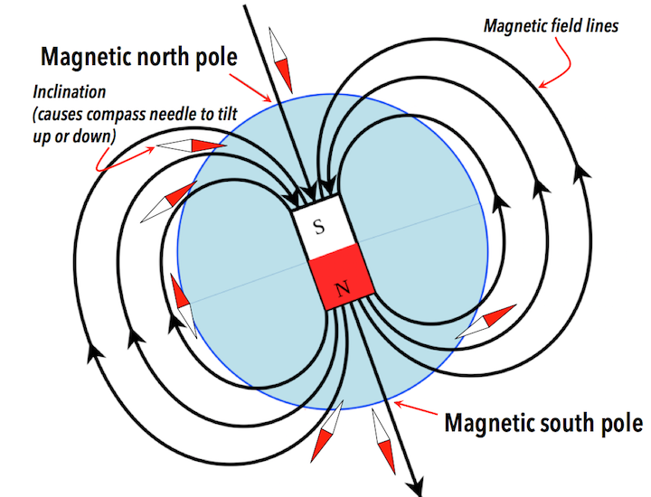
Sea Turtle Magnetoreception
Magnetoreception: an organism sensing the earth’s magnetic field for navigation and orientation

Slide 48
Sea Turtle Magnetoreception
Magnetic Fields differ by 2 components
Inclination Angle
Intensity

Slide 49
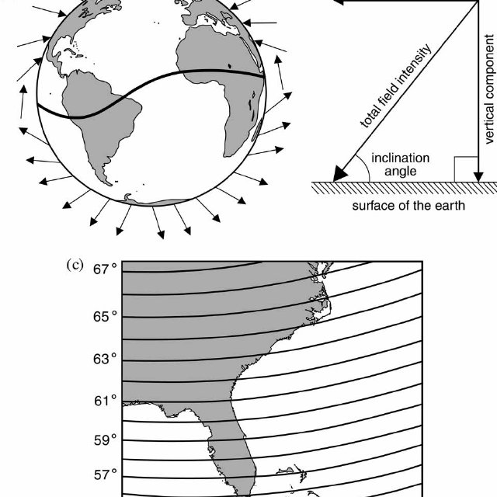
Sea Turtle Magnetoreception
Magnetic Fields differ by 2 components
Inclination Angle
Intensity

Slide 50
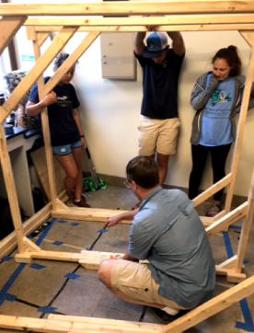
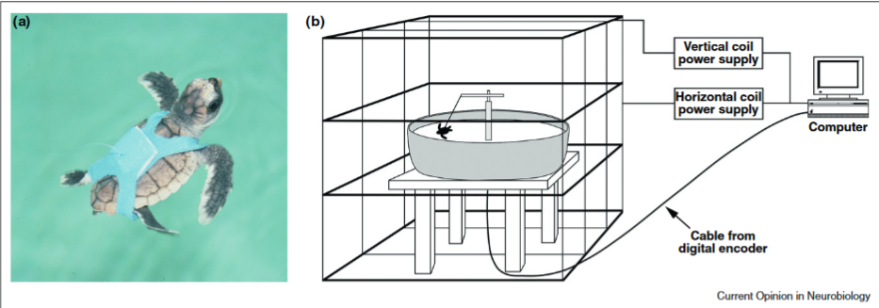
Sea Turtle Magnetoreception
Magnetic Coil: Experimental Methodology

Slide 51
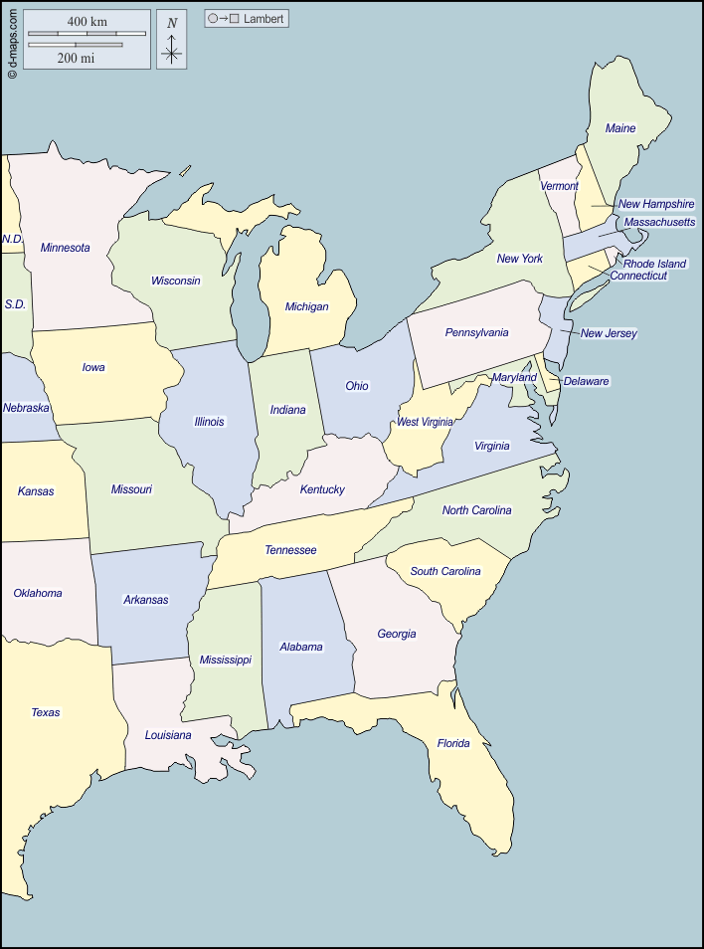
Sea Turtle Magnetoreception

Slide 52
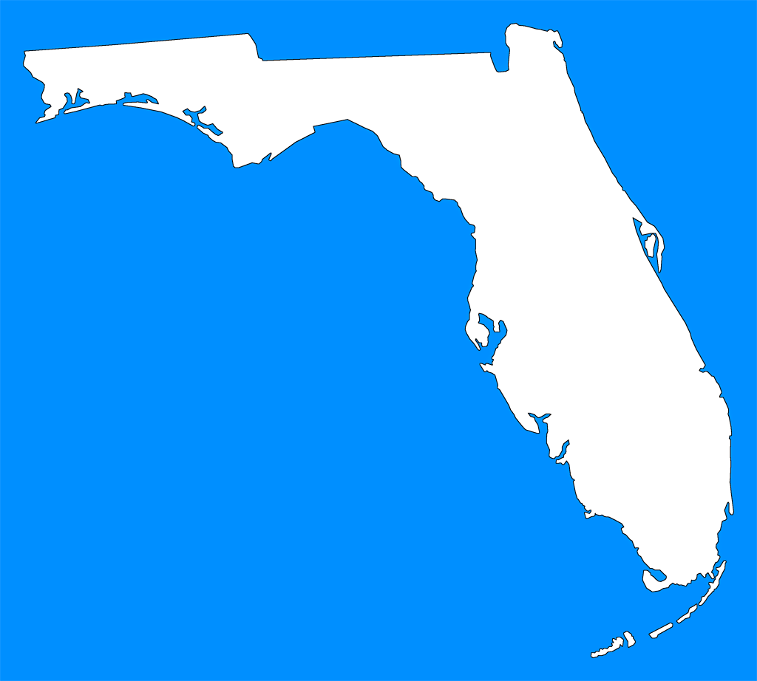
Sea Turtle Magnetoreception

Slide 53

Loggerhead Life History
Hatch at beaches along E. United States
  Usually at night or early morning
  Temperature Dependent Sex Determination
Make their way to the ocean, then swim 20-hours to the Gulf Stream
Live and feed in sargassum
  Protection and food source

Slide 54
Loggerhead Life History
Hatch at beaches along E. United States
  Usually at night or early morning
  Temperature Dependent Sex Determination
Make their way to the ocean, then swim 20-hours to the Gulf Stream
Live and feed in sargassum
  Protection and food source

Slide 55


Loggerhead Life History
Once large enough to not be eaten, they make their way to the N. Atlantic Gyre
Remain in the oceanic zone until they are large enough to return to the neritic zone (McClellan & Read, 2007)
  Why?

Slide 56

Loggerhead Life History

Slide 57

Loggerhead Life History

Slide 58



Loggerhead Life History
Natal Homing: the process of returning to one’s birth place to reproduce
  Sea turtles
  Salmon
  Bluefin Tuna

Slide 59


Title
TYPE

Slide 60
Ocean Waves and Animal Magnetism
Stage 1: Hatch
Stage 2: Make it to the ocean
Stage 3: Swim deeper
Stage 4: Find feeding grounds
Stage 5: Return to Mate/Lay eggs
Repeat

Slide 61


Stage 1: Hatch
A Boil: Hatching from the nest all at once
Immediately run to ocean

Slide 62


Stage 2: Make it to the Ocean
“Hurry! To the ocean!!”
Visual Light Cues
Orient to the brightest horizon
  Lucas et al., 1992
Notes:
Lucas, M., Salmon, M., Fritz, E., & Wyneken, J. (1992). Seafinding by hatchling sea turtles: role of brightness, silhouette and beach slope as orientation cues. Behaviour, 122(1-2), 56-77.

Slide 63


Stage 2: Make it to the Ocean
Orient to the brightest horizon
  Lucas et al., 1992
Experimental Condition
Notes:
Lucas, M., Salmon, M., Fritz, E., & Wyneken, J. (1992). Seafinding by hatchling sea turtles: role of brightness, silhouette and beach slope as orientation cues. Behaviour, 122(1-2), 56-77.

Slide 64
Stage 2: Make it to the Ocean
Orient to the brightest horizon
  Lucas et al., 1992
Control

Slide 65
Stage 2: Make it to the Ocean
Orient to the brightest horizon
  Lucas et al., 1992
Control

Slide 66

Stage 3: Swim Deeper
waves
waves
waves

Slide 67

Stage 3: Swim Deeper

Slide 68


Stage 3: Swim Deeper
Waves
Waves
Waves
Waves

Slide 69

Stage 3: Swim Deeper

Slide 70
Stage 3: Swim Deeper
Wave refraction near shore
Final Wave Direction
Initial Wave Direction
Beach
Wave Refraction Zone
Open Ocean

Slide 71
Stage 3: Swim Deeper
But how?!
  Possible Explanations
  1. Visual Cues
  2. Doplar Shift
  * Swim in different directions until a change in wave frequency is detected
  3. Wave Acceleration
  * Using the inner ear, do they detect the motion of the ocean?

Slide 72
Experiment 1: Visual Cues
How would we test if its visual cues?

Slide 73


Experiment 1: Visual Cues

Slide 74
Experiment 2: Doplar Shifts
How would we test if it’s a doplar shift?
AKA: Detecting wave frequencies
To do this, the turtle must swim in different directions a lot, but they don’t
Increased Frequency of Waves
Decreased Frequency of Waves

Slide 75

Experiment 3: Wave Acceleration
How would we test if it’s the motion of the ocean?

Slide 76

Experiment 3: Wave Acceleration

Slide 77

Wave Simulator
Positioned the Wave Simulator so that the “waves” came from different directions. Then we measured which direction they “swam” in.

Slide 78
Wave Simulator

Slide 79


Slide 80


turning left
swimming straight
turning right

Slide 81


Slide 82
Stage 4: Find Feeding Grounds
Olfactory Cues (Pfaller et al., 2020)
Remember feeding grounds with magnetic reception
Experiment:
  Utilize Classical Conditioning
  Feed at one “location” don’t feed at another
  Measure Feeding response after the magnetic field is changed
Notes:
Pfaller, J. B., Goforth, K. M., Gil, M. A., Savoca, M. S., & Lohmann, K. J. (2020). Odors from marine plastic debris elicit foraging behavior in sea turtles. Current Biology, 30(5), R213-R214.

Slide 83
Stage 5: Return for Reproduction
How do the turtles find their home beach?
  Magnetoreception
Evidence
60°
59°
58°

Slide 84
Stage 5: Return for Reproduction
Secular Variation: change in the Earth’s Magnetic Field over time
Causes Isolines converge and diverge
60°
59°
58°

Slide 85
Stage 5: Return for Reproduction
Secular Variation: change in the Earth’s Magnetic Field over time
Causes Isolines converge and diverge
60°
59°
58°

Slide 86
Stage 5: Return for Reproduction
So this is what happens on a normal year, where the isolines are neither converging nor diverging
60°
59°
58°

Slide 87
Converging Isolines
What do we predict would happen here?
60°
59°
58°

Slide 88
Diverging Isolines
What do we predict would happen here?
60°
59°
58°

Slide 89

Results
No Change
Brothers & Lohmann, 2015
Notes:
Brothers, J. R., & Lohmann, K. J. (2015). Evidence for geomagnetic imprinting and magnetic navigation in the natal homing of sea turtles. Current Biology, 25(3), 392-396.

Slide 90

Sun and Star Compasses

Slide 91
Sun Compass

Slide 92


Sun Compass
Experiment
N
W
E
S

Slide 93

Sun Compass
Experiment
N
W
E
S

Slide 94
Sun Compass
Coordination with visual cues and circadian rhythm
Clock-shifted Birds
  Performed poorly when placed outside because their circadian rhythm made them think the sun was in a different location.

Slide 95

Star Compass

Slide 96

Star Compass
Indigo Bunting
  High flying migrant
  Summer: North America
  Winter: Florida and South America
  Migrate South
Planetarium!

Slide 97

Star Compass
Planetarium Experiment

Slide 98
Star Compass
Planetarium Experiment

Slide 99

In-Class Assignment
QR CODE:
Thank you! Please provide constructive feedback of my lecture. It helps me get better!
Matthew Babb
mbabb4@student.gsu.edu

Slide 100
THANK YOU!
Matthew Babb
mbabb4@student.gsu.edu

